Slide 1
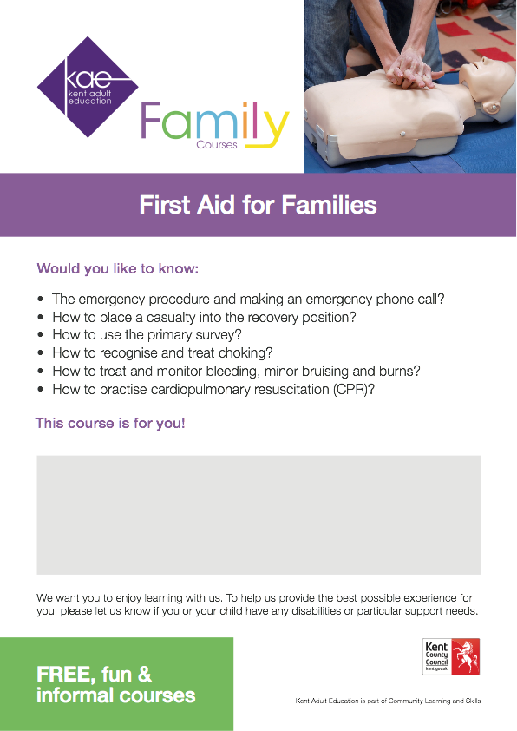

First Aid for Families (virtual course)
Dates: Mondays 1pm-3pm 1st June- 15th June or 22nd June – 6th July
Wednesdays 9:30-11:30 am 3rd June- 17th June or 24th June – 8th July
Fridays 9:30-11:30am 5th June – 19th June
To book a place please call 03000 415888 or email
BusinessSupportTeam@kent.gov.uk

