Slide 1
Year 3 Parent Information Session
Wednesday 9th September 2026
Mrs Graham and
Miss Gore
With faith, endeavour to achieve

Slide 2
Aims
Routines and timetable
Curriculum
EOY Expectations
Pastoral support / Wellbeing
Safeguarding
Attendance
Key Dates
How you can help us

Slide 3
Routines and Timetable
8:40 - Reading / Registration
8.55 - Spelling
9:10 - Maths
10:00 – Collective Worship
10:15 – Break
10:30 – Shared Reading
11:20 – Writing
12:00 - Lunch
1:00 - Handwriting
1:15 – Maths Mastery/Times Tables
1:30 – Wider curriculum
3.00 - Class reader
3:15 - Home

Slide 4
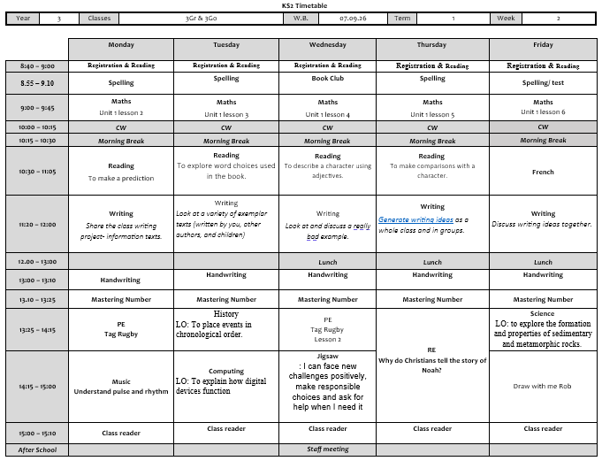
Routines and Timetable

Slide 5
Curriculum
SHARED READING
Whole school policy
Daily shared reading session in school
READ and DISCUSS - Expectation that children read to an adult at home 15 mins 3x weekly.
Children need to have read the book AT LEAST once to an adult and have their reading log signed.
When they finish a book they can write a book review if they like.
Please speak to us if you are unsure about your child’s reading book, or would like some ideas on how to support reading at home.

Slide 6
Curriculum
Accelerated Reader Programme –
Each child has a reading range given to them by
the Star Reading comprehension test.
They can select a book of their choice within their range, and a book one point out of their range for reading for pleasure.
Please encourage your child to make good book choices and finish each book.
Each week we have Book Club there is also opportunities for children to decide whether to read silently or with a friend.
AR – home quiz

Slide 7
Curriculum
WRITING 4 PLEASURE
Mix of fiction and non-fiction, and poetry.
This term – the welcome project and poetry.
Planning, drafting, editing and publishing pieces of writing.
Personal Writing Books whilst pupil conferencing takes place.
High standard of handwriting expected across all subjects – Every morning.
Develop a neat, fluent style. Learning letter joins
Spelling Shed for spellings – Login in Reading Log (weekly on a Friday for following Friday)

Slide 8
Curriculum
MATHS
Oak Academy
Lots of hands on, practical maths
Learning a range of mental / written methods of addition, multiplication, subtraction and division
Problem solving and reasoning integrated into lessons
Number bonds (to 10, 20, 100 and 1000)
Times tables (2, 5, 10, 3s until end of Autumn) 4s, 8s and 6s
Calculations policy on website
Times table Rockstars- login in Reading Log.
Daily Maths Fluency/Mastering Number

Slide 9
Curriculum
WIDER CURRICULUM
Cross curricular links where possible
History and Geography are alternate terms
Art and DT are alternate terms
Music, French, Science and PSHE, Computing RE – weekly
PE – Monday and Wednesday
Use outdoor spaces as much as possible

Slide 10
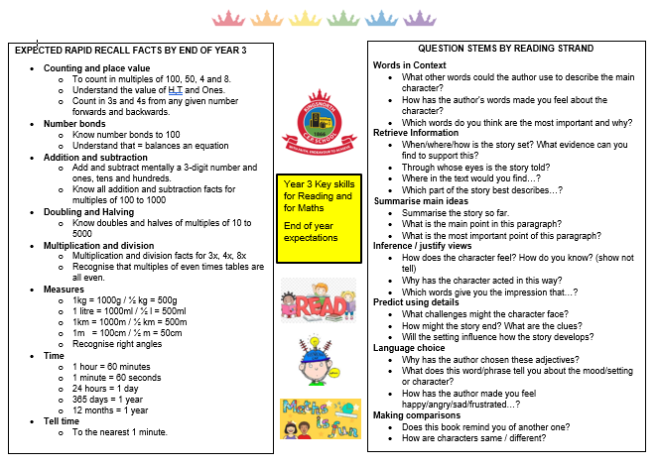
End of Year Expectations

Slide 11
OPaL
Wellington boots / waterproofs as out what ever the weather.
Creating quality play for all children as this will improve behaviour, resilience, problem solving, social skills and team work.

Slide 12
School Organisation
Team – Middle School Corridor (2,3,4) Mrs Nock Team Leader
Year group teaching - Class swap for some sessions and joint lessons.
The Teaching Assistants who work with Year 3 are Mrs B and Mrs Giles
Cover supervisors who the class may be taught by from time to time are: Mr C-P

Slide 13
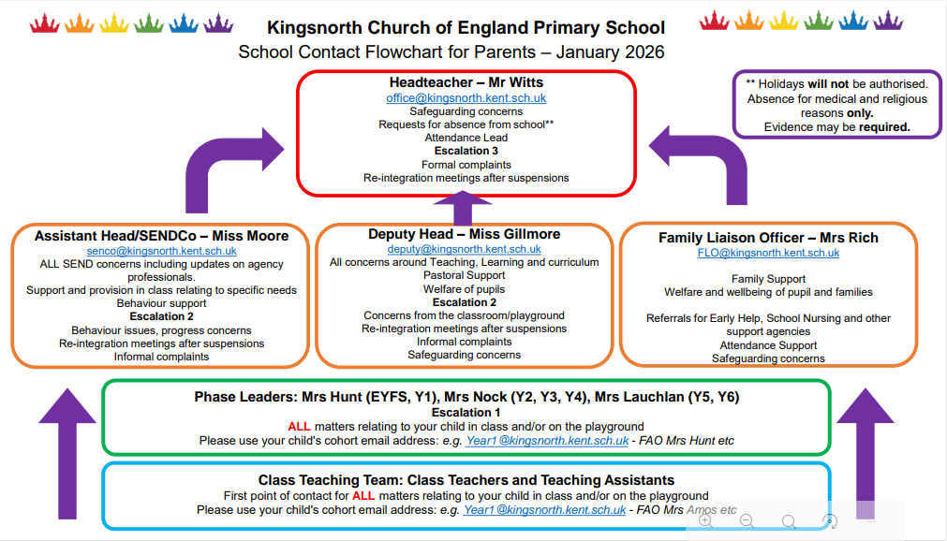
School Organisation

Slide 14
Behaviour
Be Safe
Be Ready
Be Respectful
Behaviour Policy is on our website
Children can wear one pair of stud earrings (not in PE) and a wrist watch (not smart). No other jewelley.

Slide 15
Pastoral Support and Wellbeing
ZOR
Mental health and wellbeing through curriculum
Additional support

Slide 16
Nurture
Nurture is a tried and tested way of relating to children that helps them develop vital social skills, confidence and self-esteem, and become ready to learn.
Kingsnorth has a whole school approach as well as providing children with the opportunity to have time with out Nurture Lead and work within a small group.
Children that are identified as requiring additional nurture intervention will be identified with the class teacher and or the SENCo.

Slide 17
SEND
Special Educational Needs and Disability
Miss Moore is the SENCo
Children are identified as SEN through the discussions with Parents, Class teacher, and SENDco
If you would like to discuss any concerns please feel free to make an appointment with the SENCo senco@Kingsnorth.kent.sch.uk

Slide 18
Key Dates
KS2 Parent Reading Workshop – 5th October 2:30pm
KS2 Parent Maths Workshop – 12th October 2:30pm
Parent Consultation – 21st & 22nd October
PGL – 6th May 2027
3 Gr class assembly – Term 3
3 Go class assembly – Term 6

Slide 19
Safeguarding
Online safety item weekly on Newsletter
Safeguarding in our curriculum
Safeguarding calendar of events for parents in school
What we may ask your child to do online / websites we may use
What to do if you have a safeguarding concern
As per our Health and Safety Policy children should have a red Book Bag not a rucksack.

Slide 20
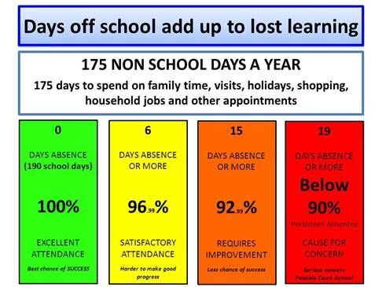

Slide 21
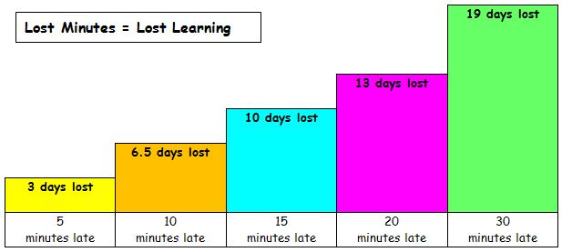
PUNCTUALITY DATA

Slide 22

Parent Partnerships
Many ways to contact us!
After school conversations
Parent Forum
SENDco coffee mornings
Open classrooms
Drop in reading and learning sessions
Home School Agreement
PFA events (class lists)

Slide 23
And finally...
Contact us via the school office or the email below
Keep up to date via the school website, texts and newsletters.
year3@kingsnorth.kent.sch.uk
Any questions?

Slide 24
Thank you for listening.
With faith, endeavour to achieve

