Slide 1
Stations of the Cross 2026
at Kingsnorth CEP

Slide 2
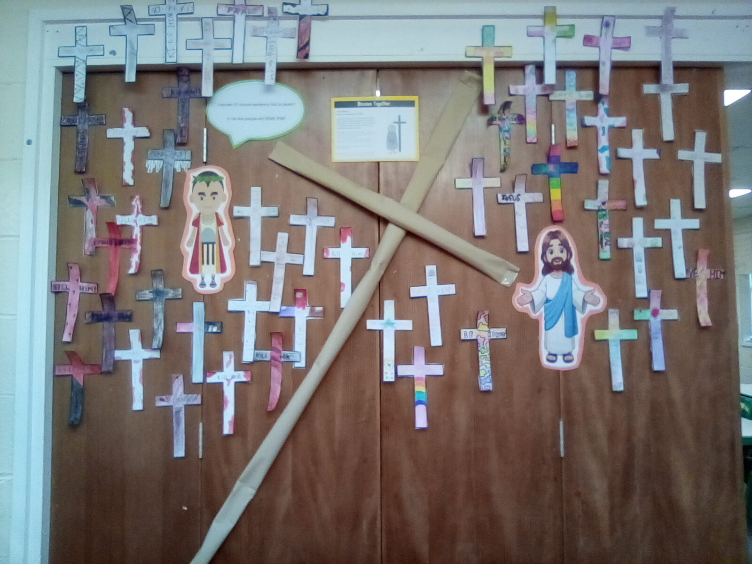
Station I
Jesus is sentenced to death
By 6L

Slide 3
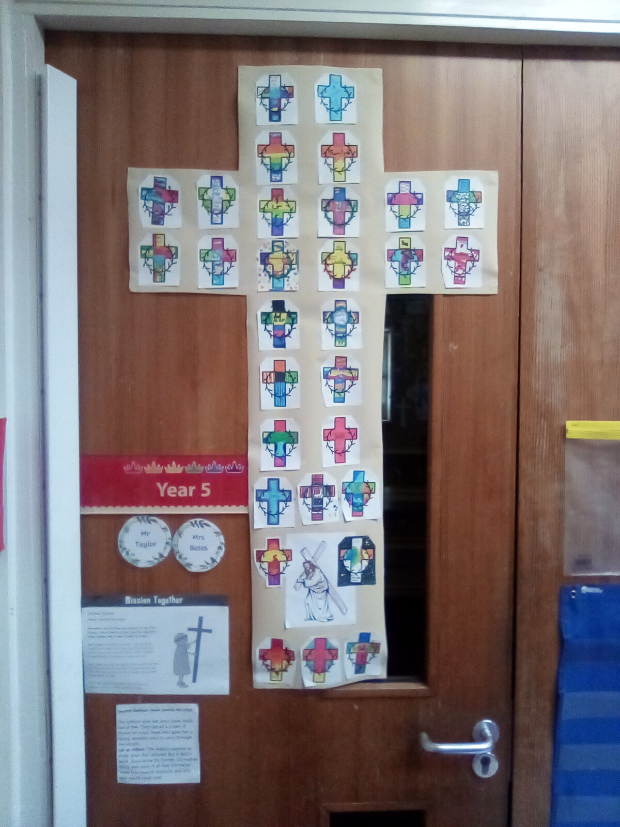
Station II
Jesus Carries His Cross
By 5T

Slide 4
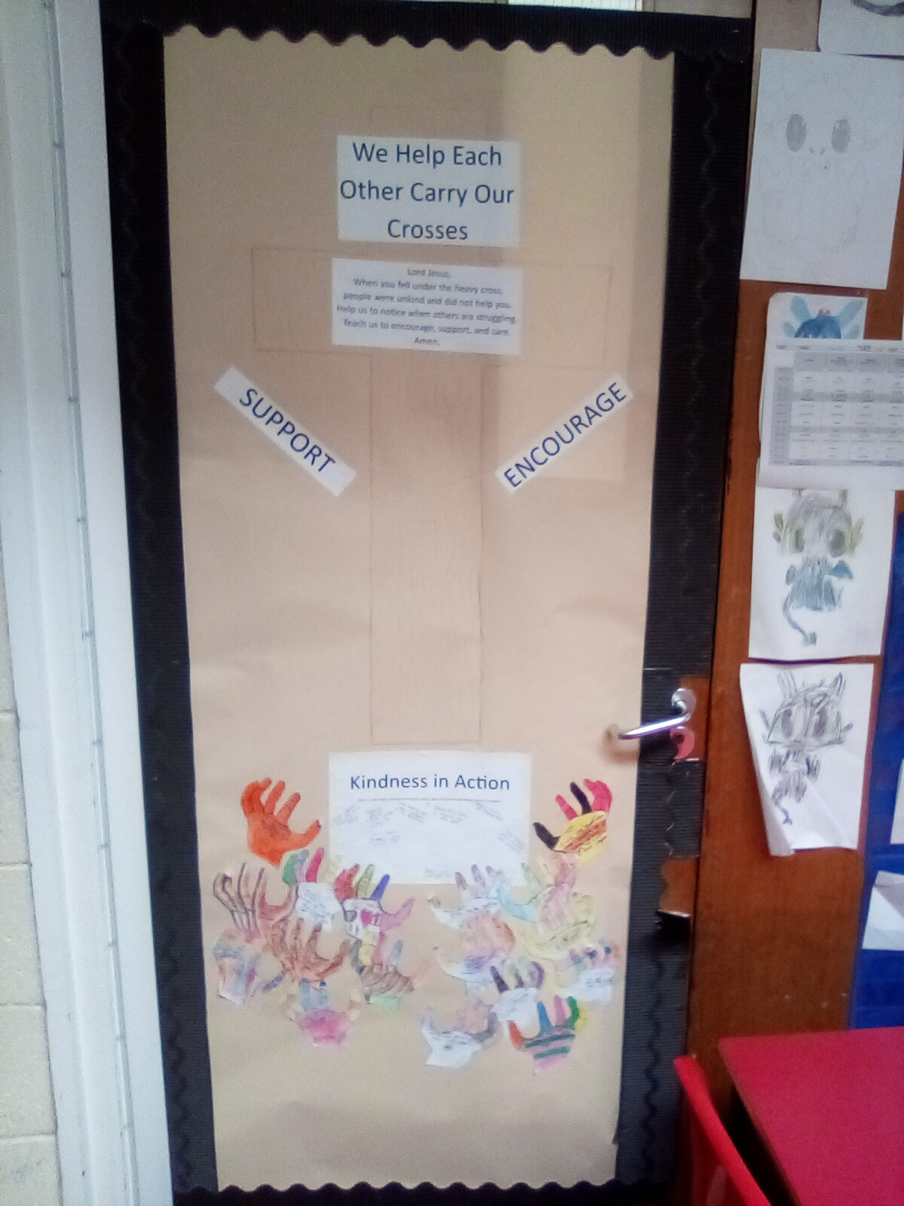
Station III
Jesus falls for the first time
By 4N

Slide 5
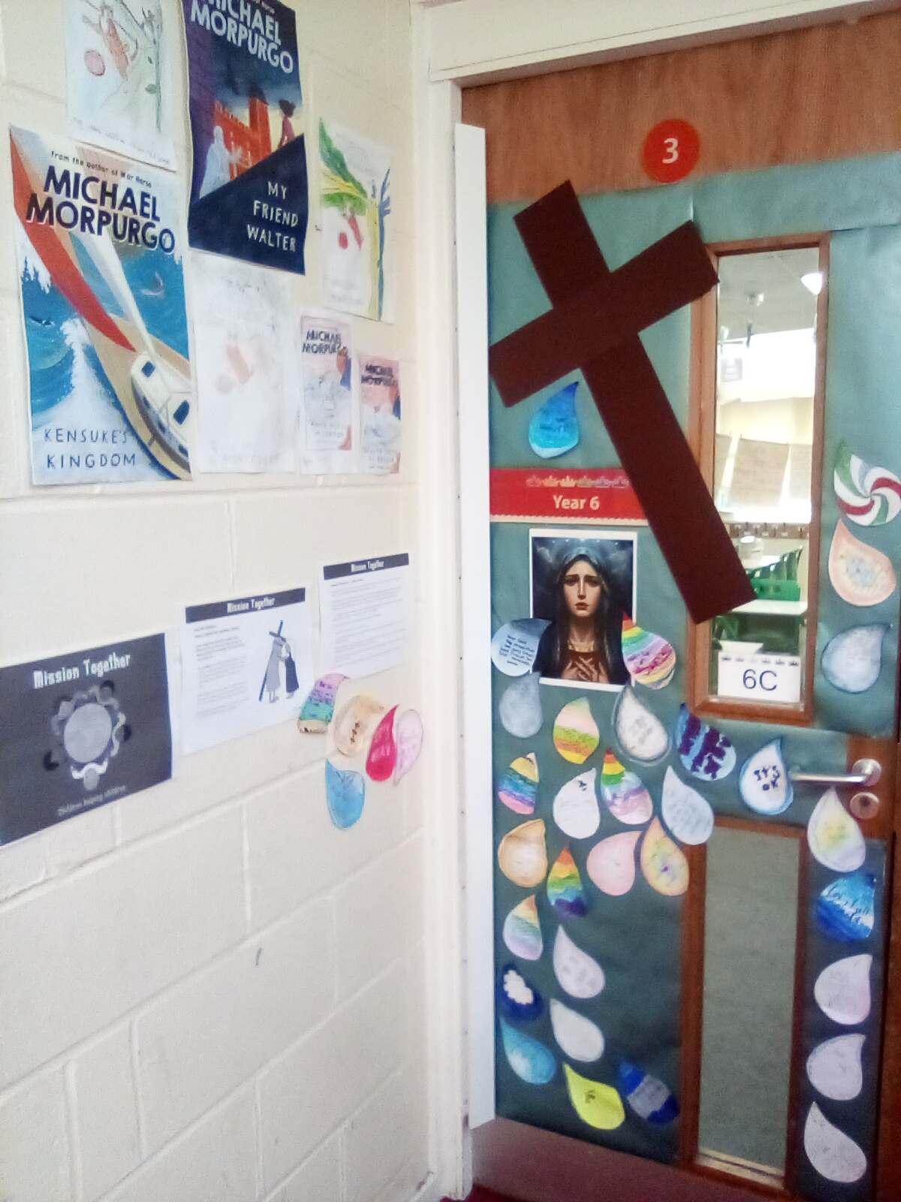
Station IV
Jesus meets his mother, Mary
By 6C

Slide 6
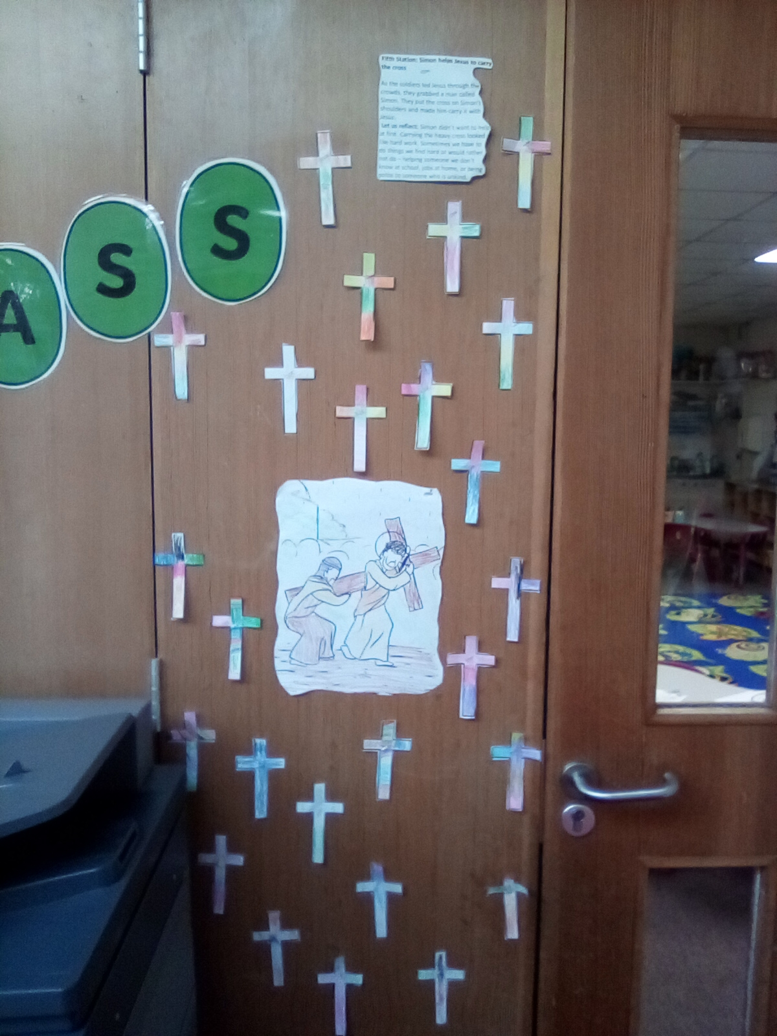
Station V
Simon helps Jesus carry the cross
ByRH

Slide 7

Station VI
Veronica wipes Jesus’ face
By RF

Slide 8
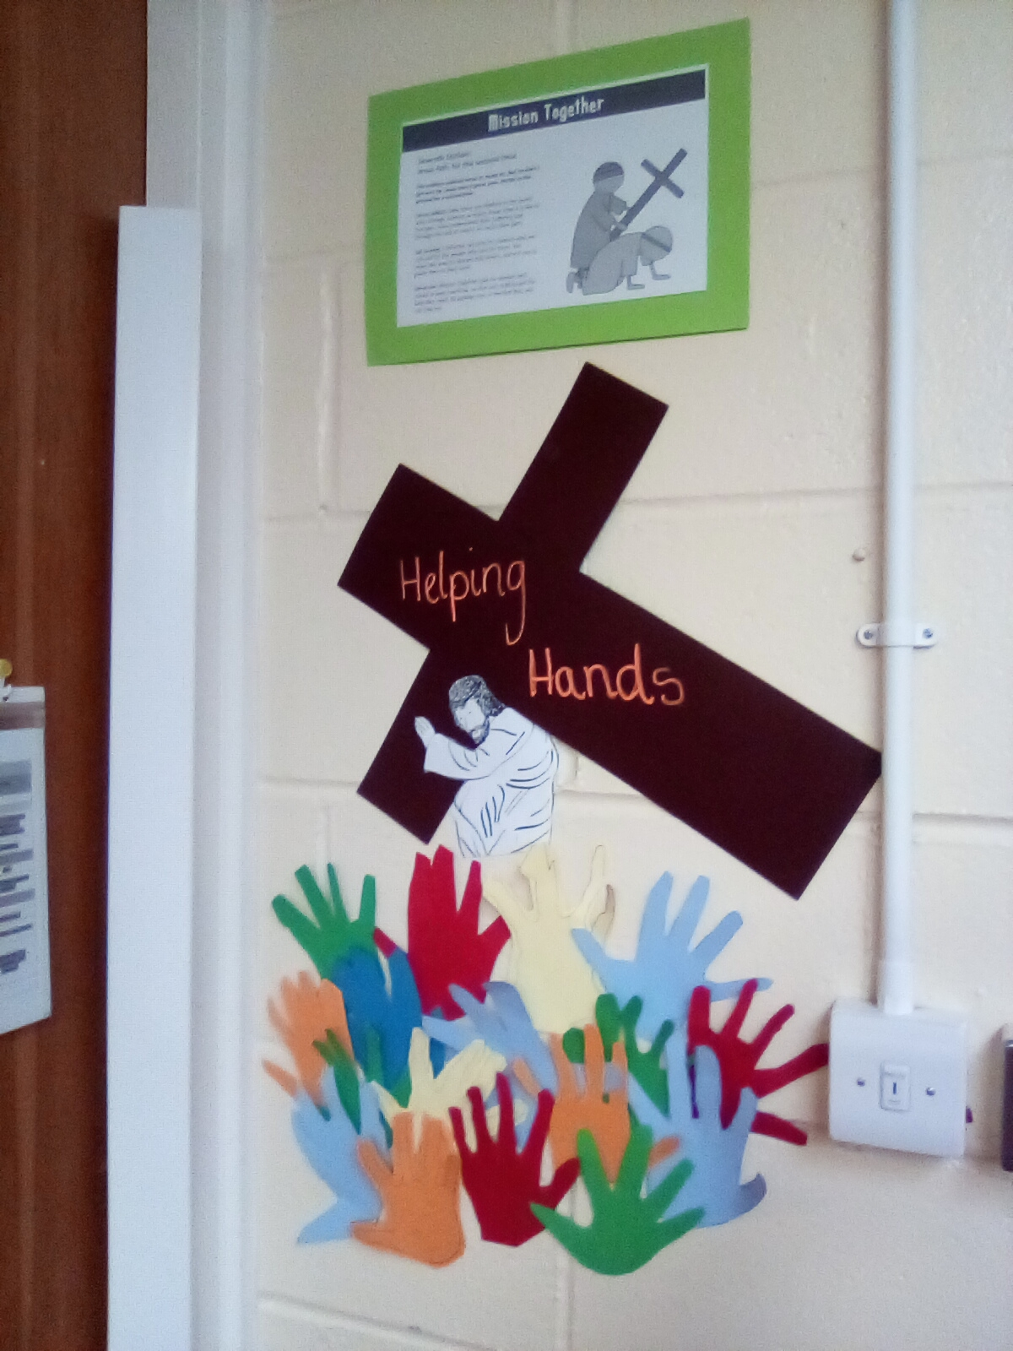
Station VII
Jesus falls for the second time
By 1B

Slide 9
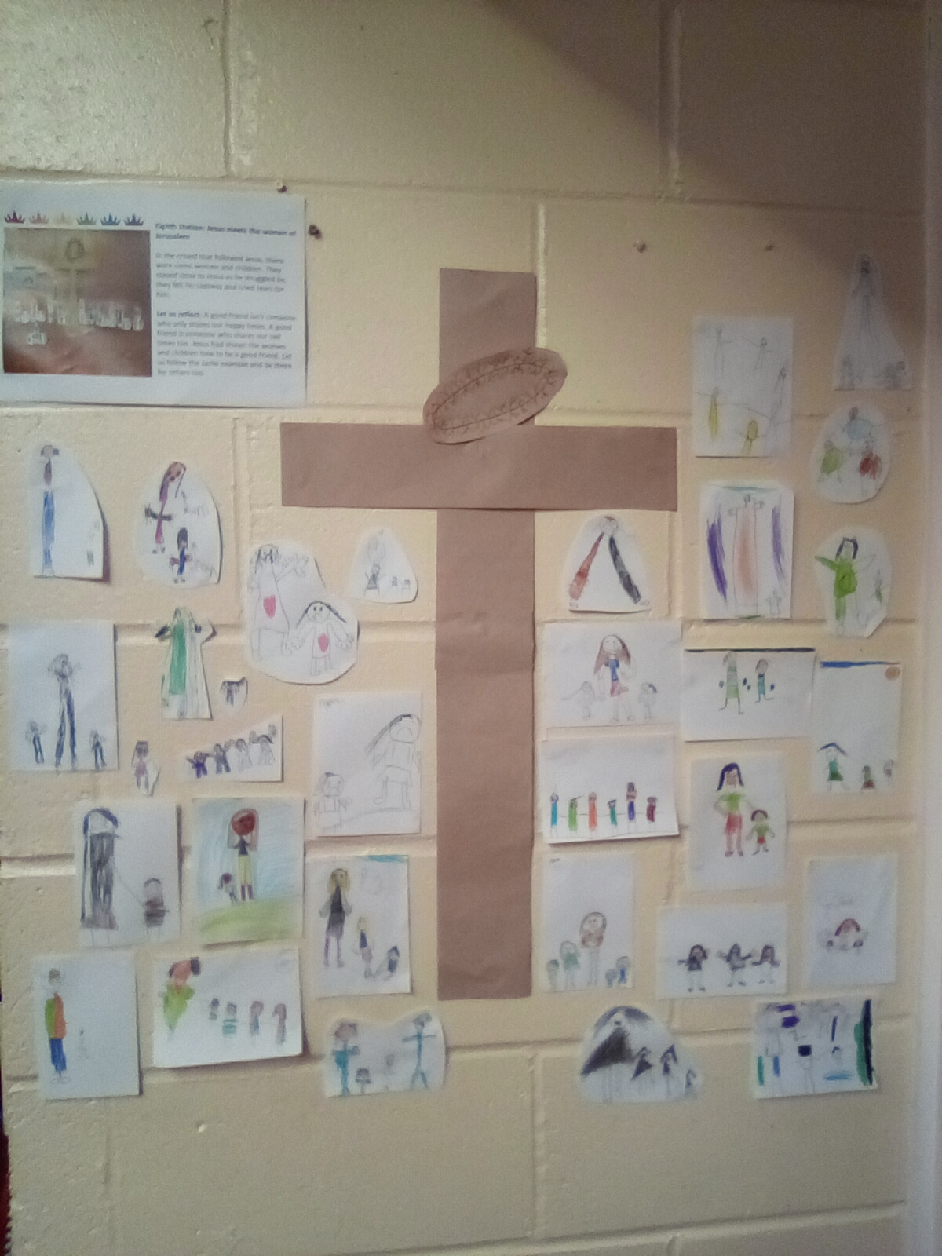
Station VIII
Jesus meets the women of Jerusalem
By 1A

Slide 10
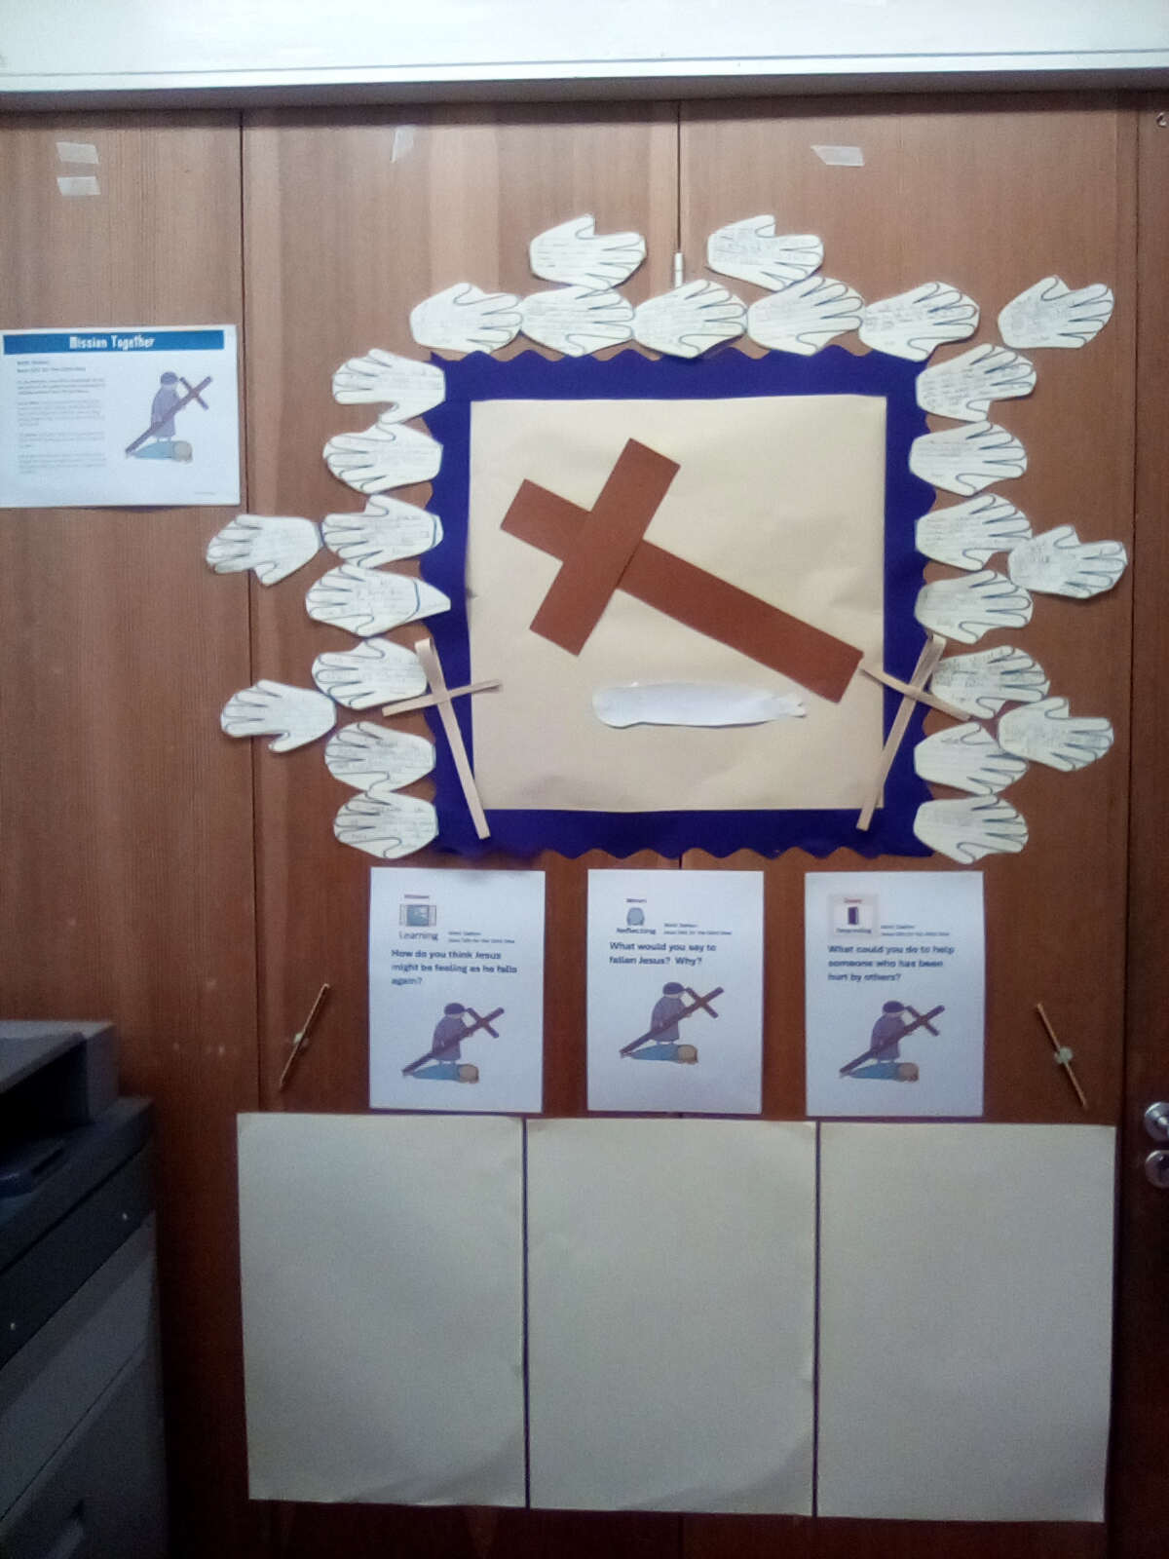
Station IX
Jesus falls for the third time
By 2K

Slide 11
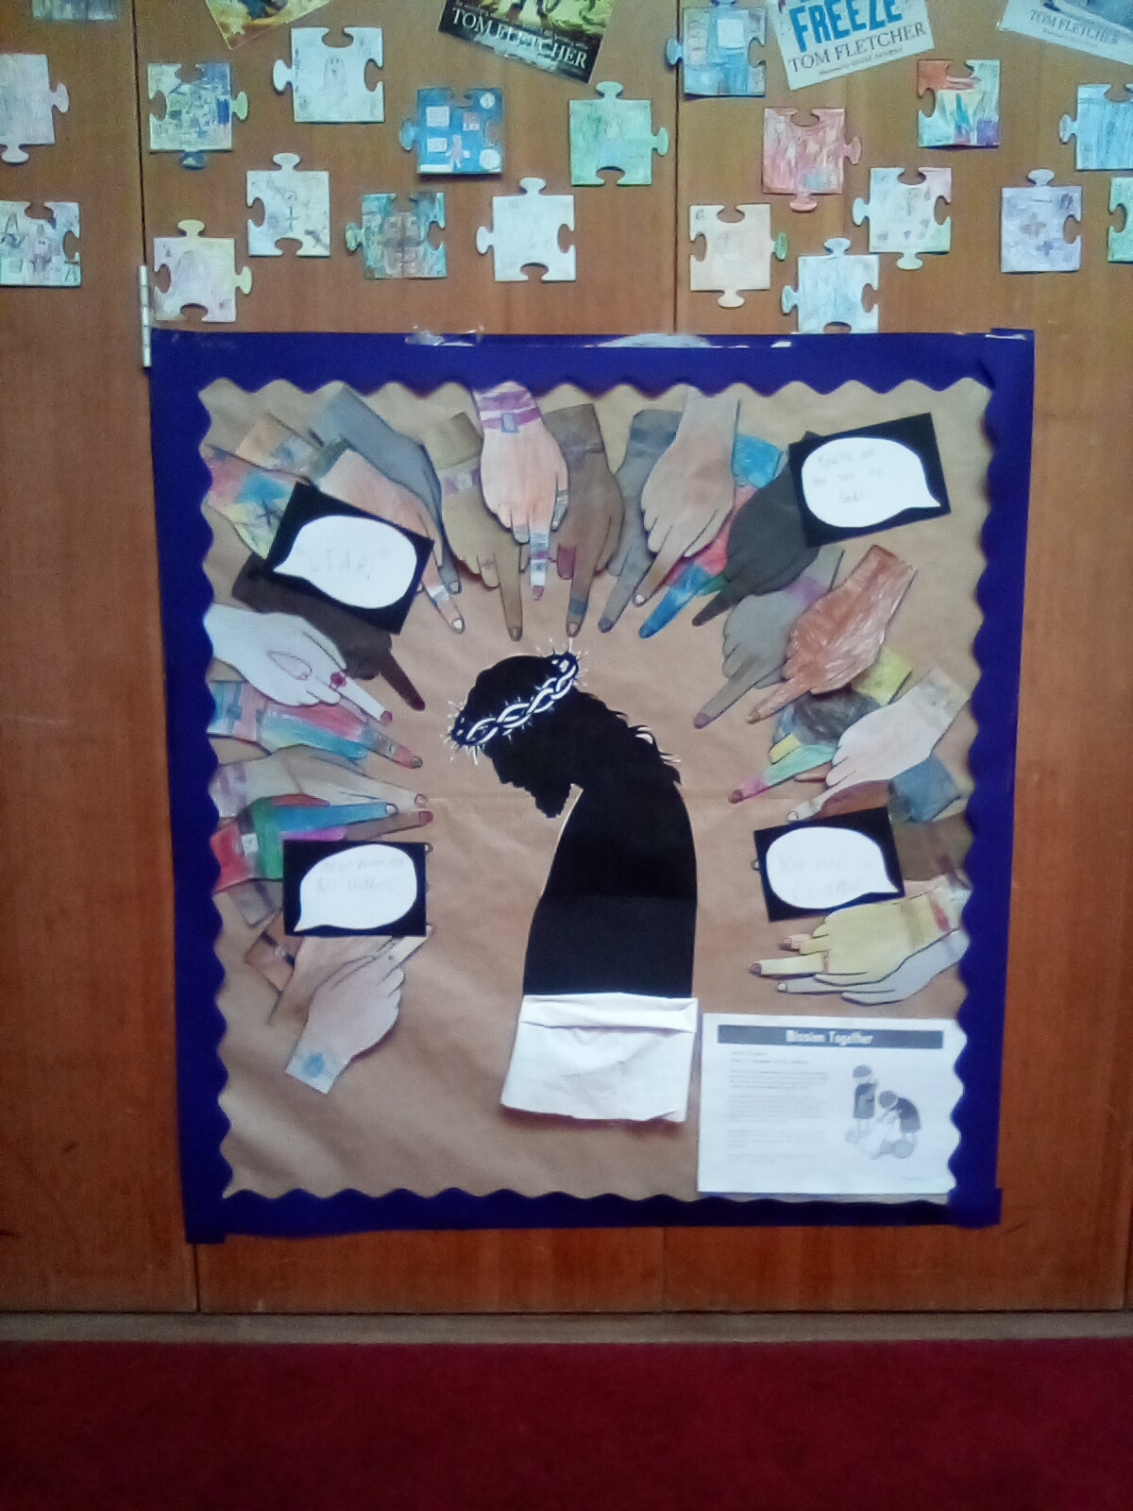
Station X
Jesus is stripped of his clothes
By 3G

Slide 12
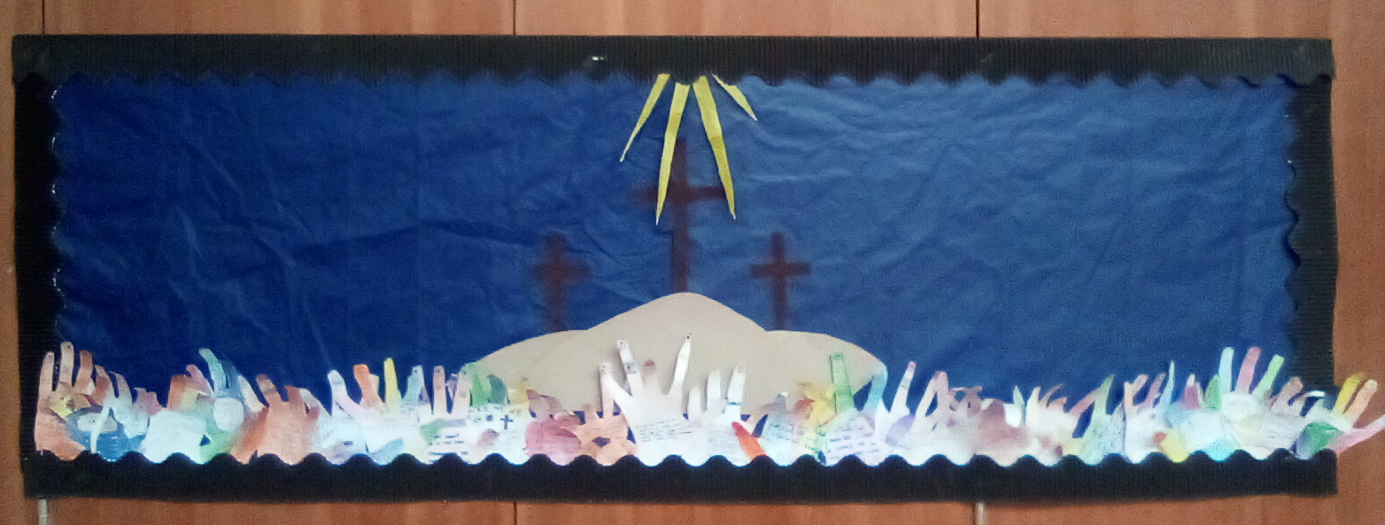
Station XI
Jesus is nailed to the cross
By 4S

Slide 13
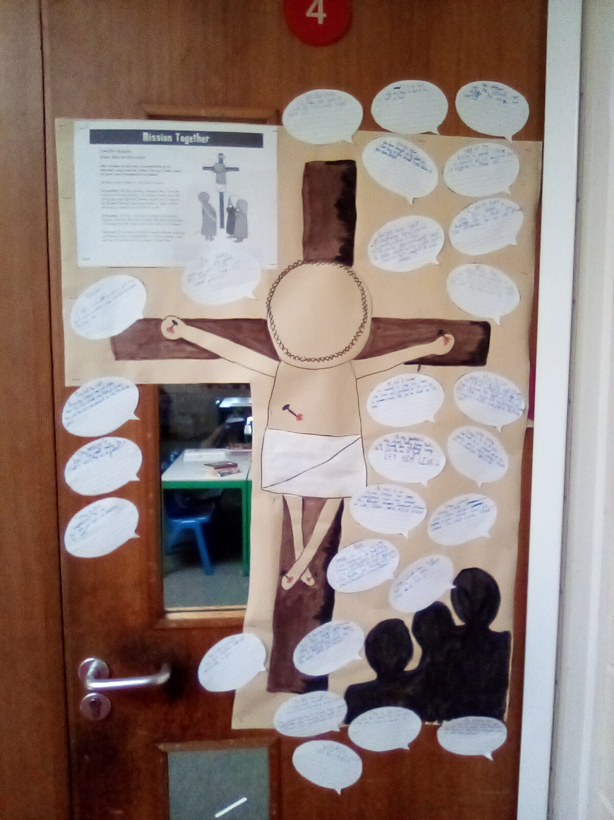
Station XII
Jesus dies on the cross
By 5B

Slide 14
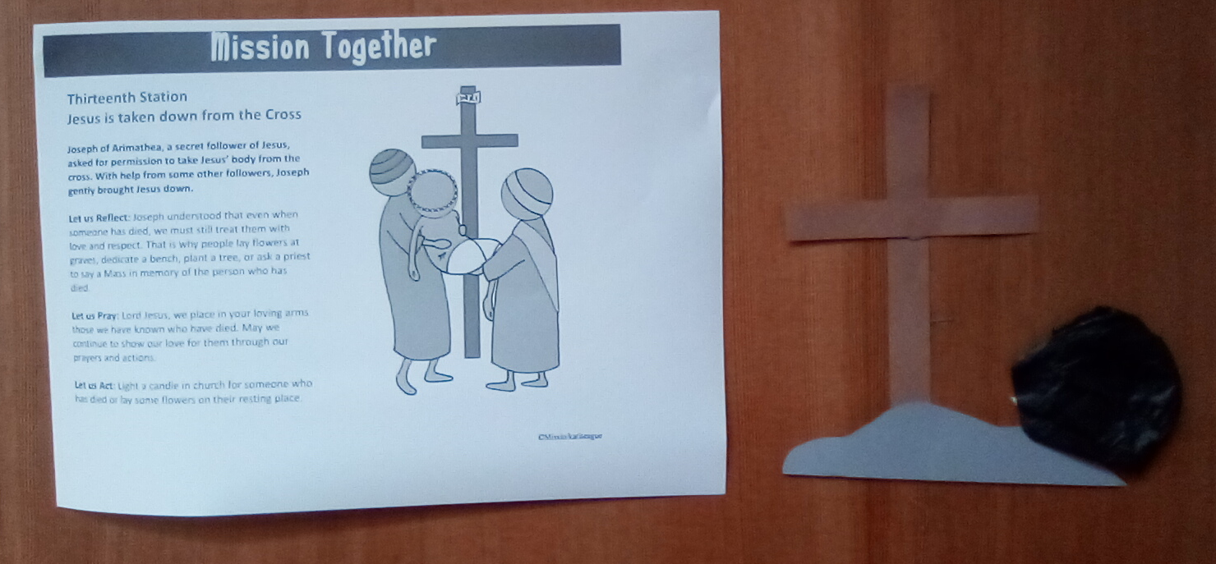
Station XIII
Jesus is taken down from the cross
By 3H

Slide 15
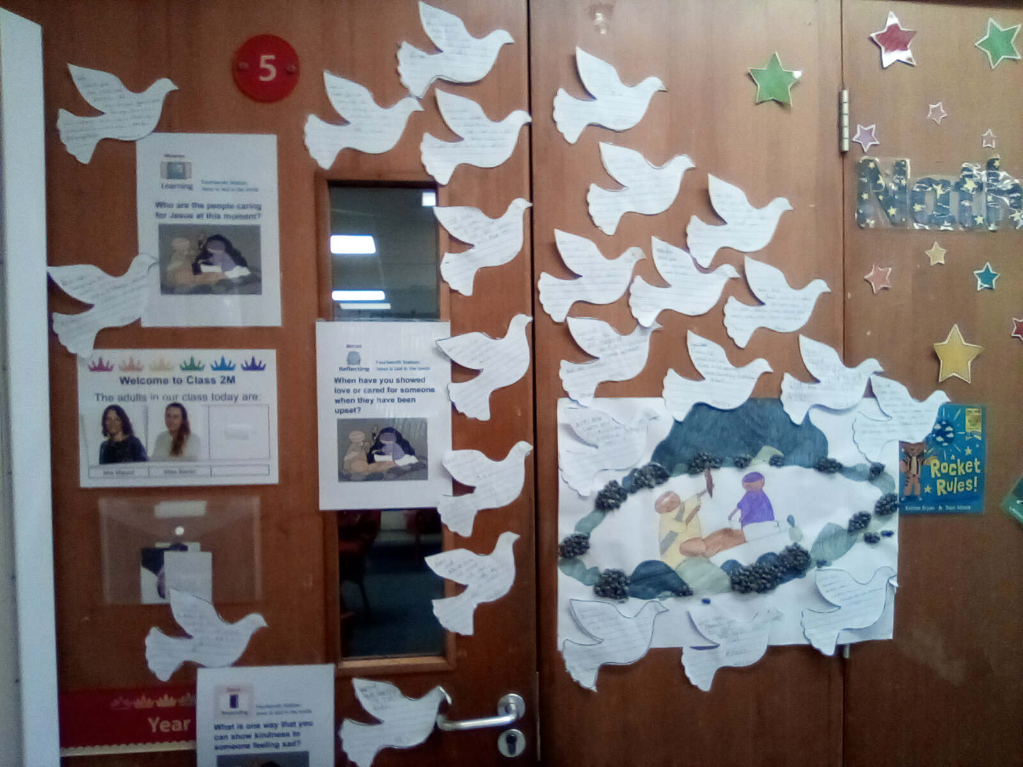
Station XIV
Jesus is laid in the tomb
By 2M

