Slide 1
Y6 Parent Information Session
Isle of Wight Residential
Tuesday 9th September 2025
Mrs Lauchlan
Mr Clark
With faith, endeavour to achieve

Slide 2
Travel Arrangements
We will be travelling with Crosskeys Coaches, the coach is taking us all the way to the residential. There are no toilets on the coach so we will be stopping at Clacket Lane Services.
Outward Journey: We leave school at 9.30 and arrive at Little Canada (PGL) at 15.30. Please drop your child off at 9am (no earlier) at the gate by the old building.
Return Journey: We hope to arrive back at school by 16.00 You will be notified by text of any change to these times.
The school office will notify parents by text during stages of the journey and to confirm our safe arrival at PGL.

Slide 3
Staffing
Mr Clark
Mrs Lauchlan
Mrs Dengate
Mrs Wright
Mr Everett
Mr White

Slide 4
Room Allocation
As a school, children write down three pupils of the same gender with whom they wish to share a room. We ensure that the children are placed with at least one of their three choices.
Much like previous years, and in line with other schools, we do not share room allocations with the children prior to the trip. We have found that this minimises the anxiety surrounding room allocations; the children are also fully aware that they will be with their chosen friend/s.
Teacher rooms are always carefully planned in line with boy to girl ratio and any children requiring reasonable adjustments.

Slide 5
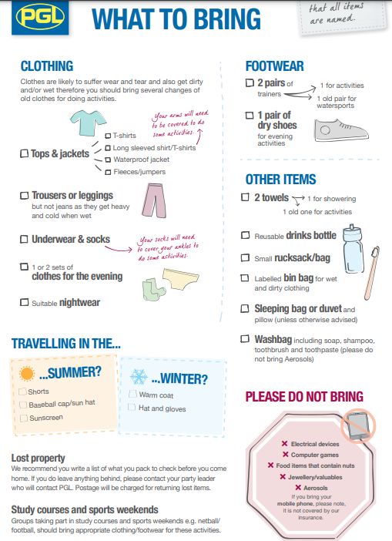
KIT List
You should have a copy of this
It will be September, evenings will be chilly, so bring some layers, hat and gloves, we are outside nearly all day!
WATERPROOF – JACKET AND SHOES – CHANGE OF SHOES.
All items need to be named

Slide 6

Do Not Bring
Money – no money is required during the residential, everything is provided
Mobile Phones/technology/smart devices - No phones are permitted during the week residential- we will be taking the school mobile to ensure regular contact with school and in the event of a medical emergency.
Snacks/sweets - No snacks/sweets are allowed due to allergens which forms part of our risk assessment – the children will just need a packed lunch in a disposable bag following our usual school lunch guidelines. A packed lunch will be provided by PGL for our return journey.

Slide 7
Other Information
Bedding – All bedding is supplied by PGL so no need for children to bring any form of bedding.
Luggage - As the children will need to carry and move their luggage by themselves, they will need a case/holdall that they can easily manage. Please avoid large suitcases.
Illness - In the event of a child becoming seriously ill, we will contact parents in order to discuss symptoms and the care being given at that time. Please contact us ahead of the trip’s departure if you feel that this will be problematic for your child and we will be very happy to chat through some options with you.

Slide 8
Other Information
What to wear for travelling - The children should wear comfortable clothes, however as we are stopping at Clacket Lane services, this year we would like all children to wear their school jumper/cardigan/fleece with the Kingsnorth Logo. The children may wear trainers.

Slide 9
Medication
The children are familiar with all members of staff attending the trip. Please ensure the medication form is completed and returned to school (By Friday 19th) so that we can plan for any medicines that need to be provided prior to departure. The children will not be allowed to administer any medicine by themselves.
Mrs Lauchlan will collect the medication on the day of the trip. Please ensure that this is in a named bag.
Travel sickness medication for the journey there will need to be given by parents prior to them arriving on the Monday.

Slide 10
Activities and Food
On arrival, children will play a settling-in game led by PGL staff.
During the week and the evenings, they will take part in multiple activities promoting their physical and mental strengths.
The children will NOT go hungry! They will be fed 3x meals a day, which consists of lots of yummy options. PGL are aware of all dietary requirements.

Slide 11
Thank you for listening.
Any Questions?
With faith, endeavour to achieve

