Slide 1



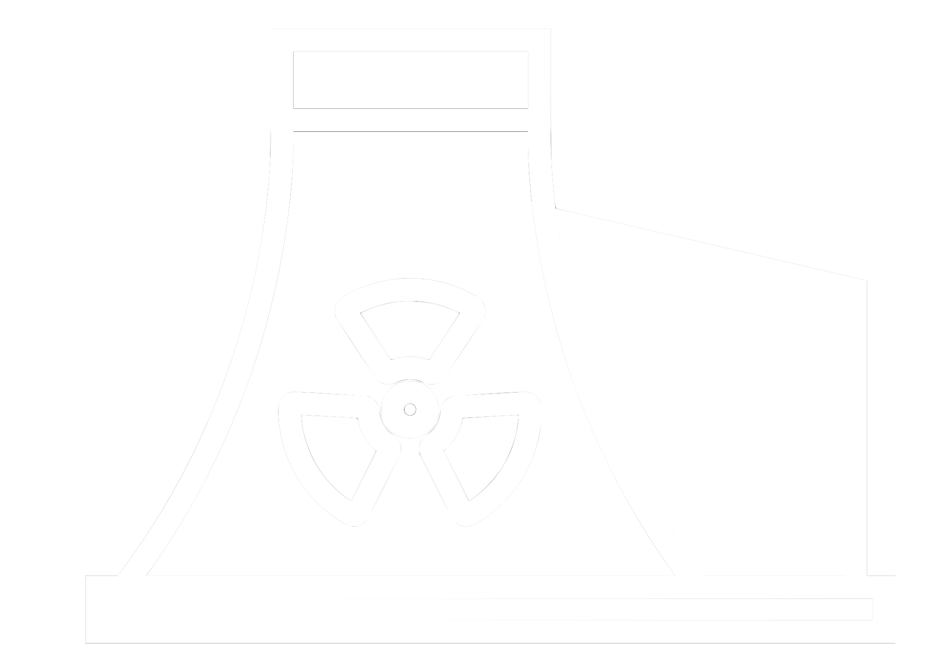






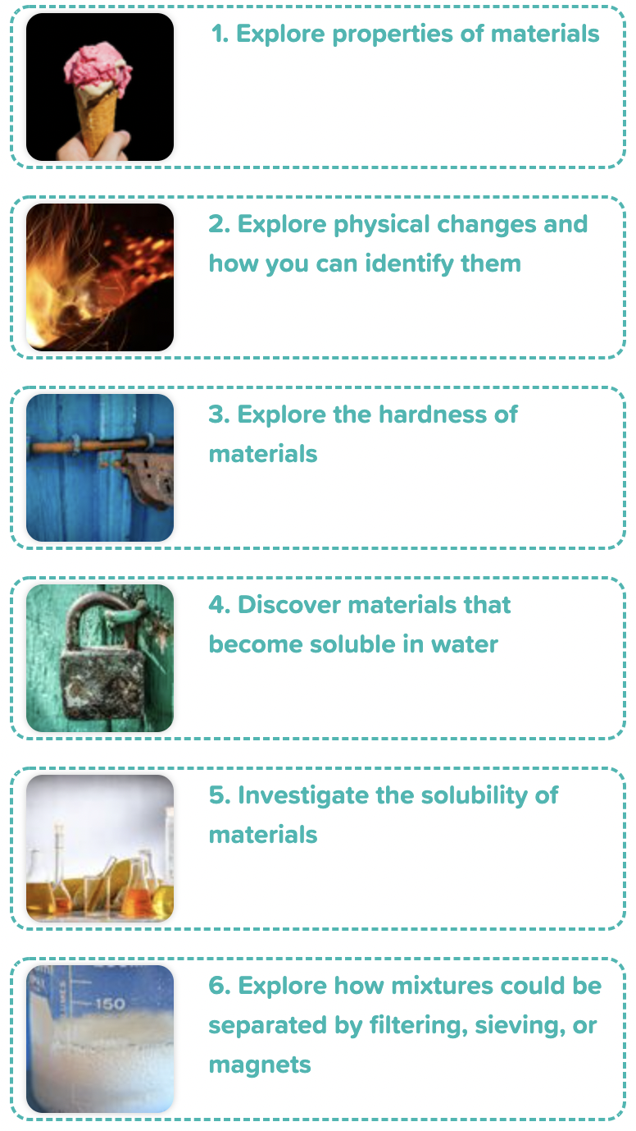
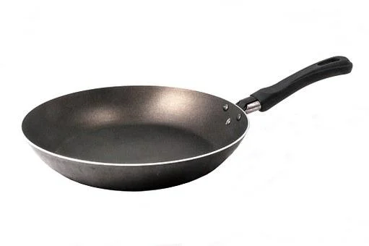










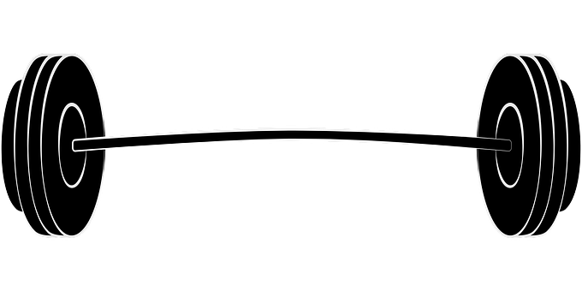

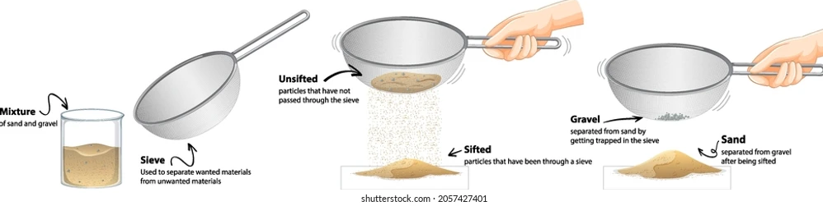
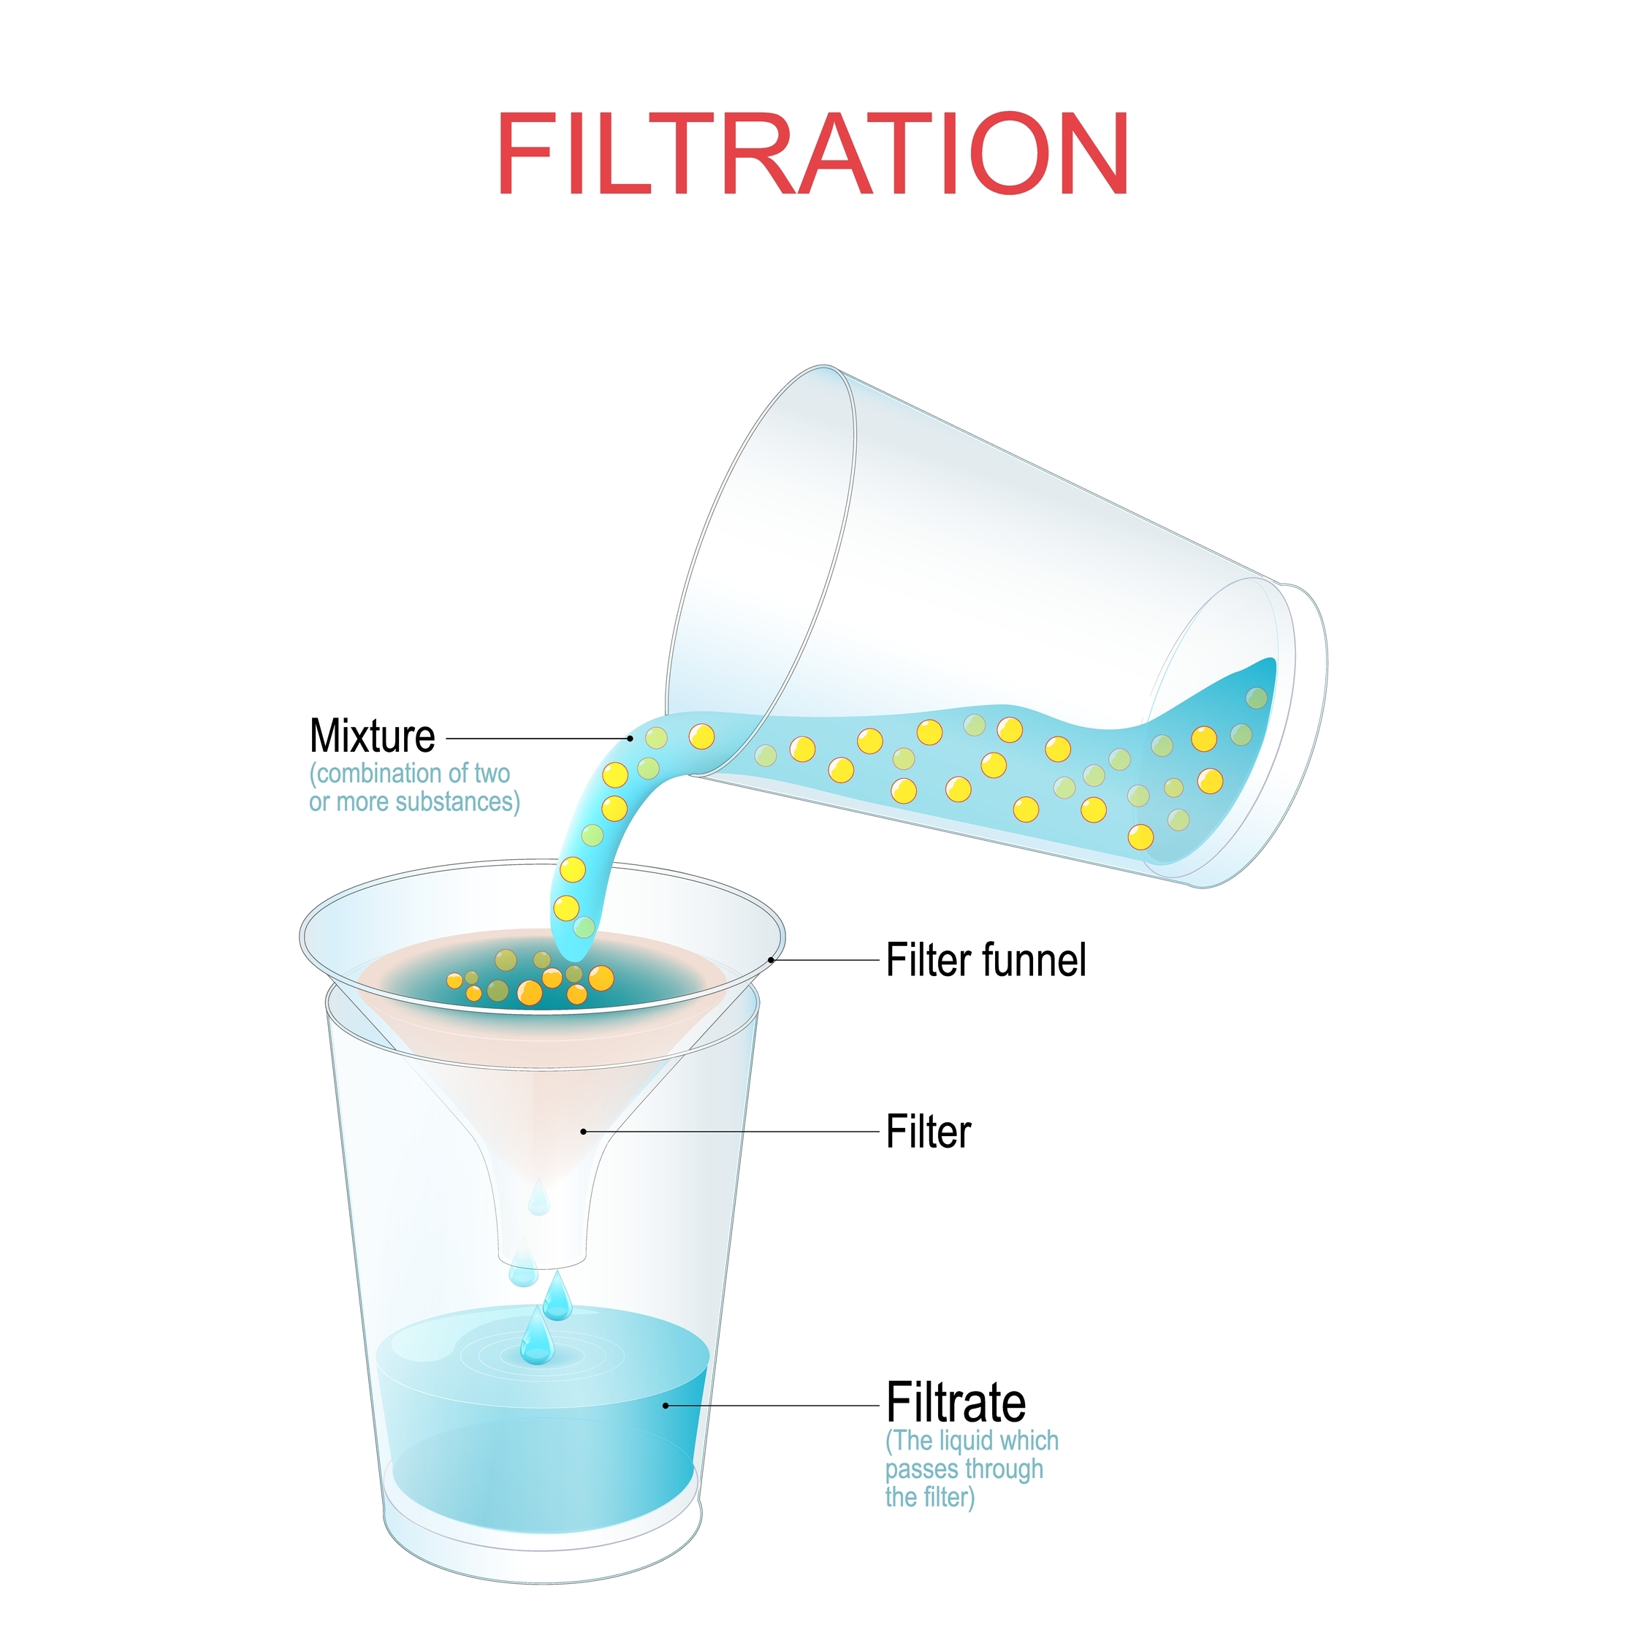
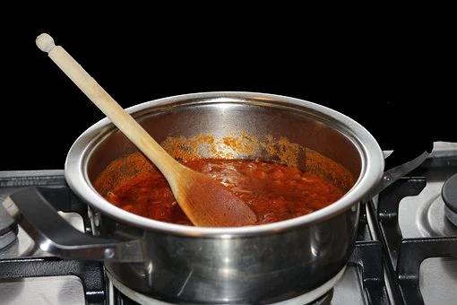
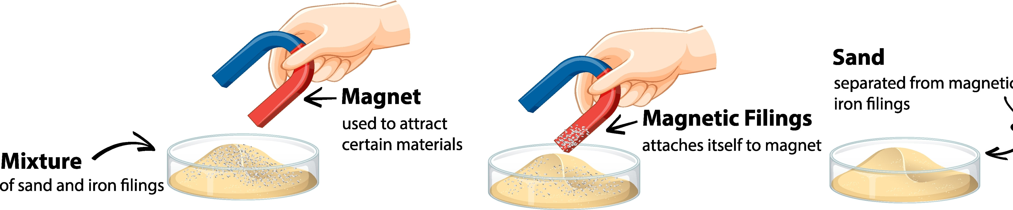
Knowledge Organiser: Year 5 Properties of Materials
Careers connected to the human body:
doctor, nurse, massage therapist, personal trainer, theatre technician
Properties of Materials
Soluble Materials
Lesson Sequence
Lesson Sequence
Some solids dissolve in water (SOLUBLE).
coffee sugar salt jelly
Some solids do not dissolve in water (INSOLUBLE).
pepper sand wax
1. Explore properties of materials
conducts energy
insulates energy
transparent
waterproof
durable (strong)
magnetic
2. Explore thermal conductors and thermal insulators
3. Explore hardness of materials
Separating Materials
4. Discover materials that are soluble in water
Sieving
Filtering
Everyday Materials
Metal saucepans conduct heat to warm food.
5. Investigate the solubility of materials
Magnetism
Magnetic metals:
iron
nickel
steel
6. Explore how mixtures can be separated by filtering, sieving, evaporating or magnets
Wooden spoons and plastic handles insulate heat so hands do not get burned.
Developing Experts Copyright 2022 All Rights Reserved

Slide 2

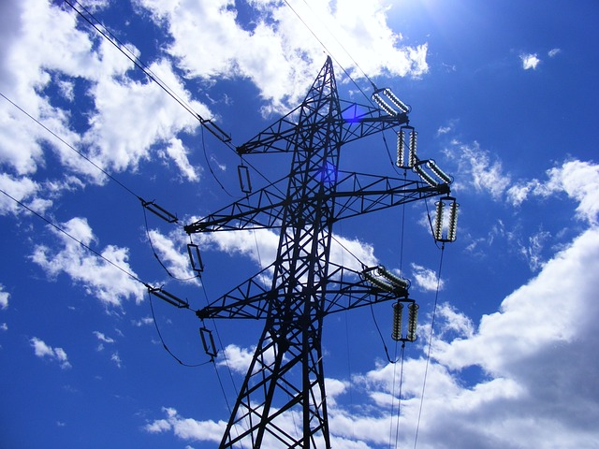
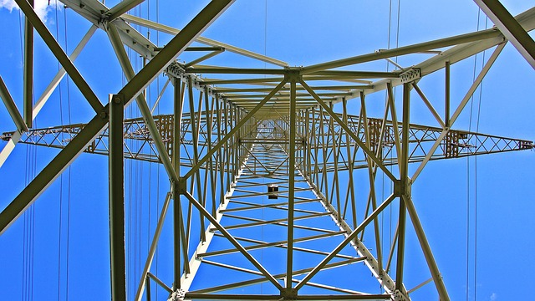
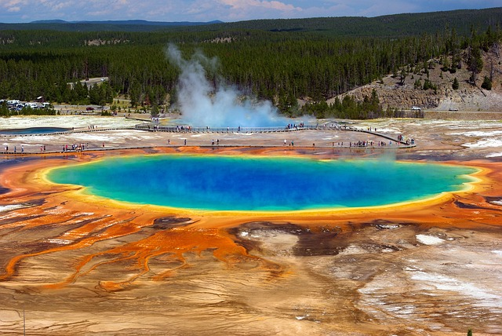
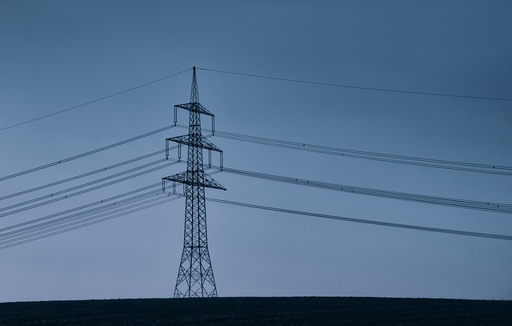
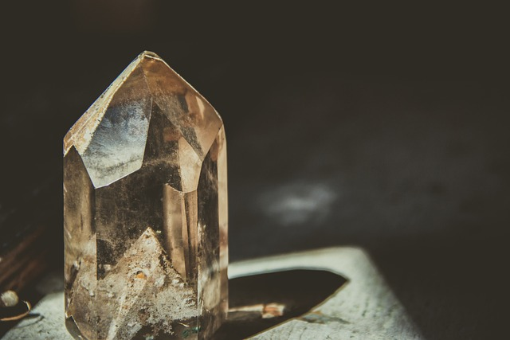
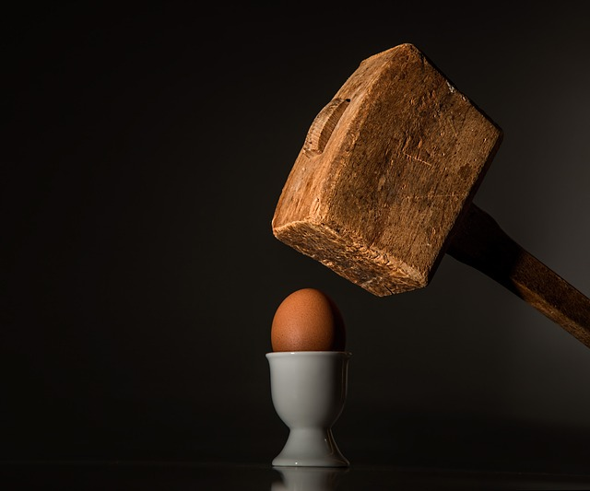



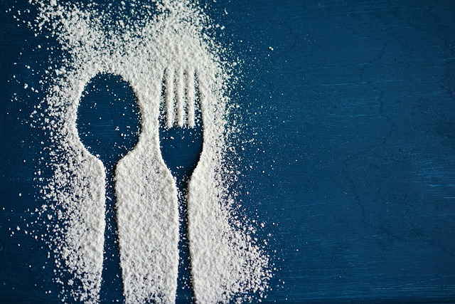
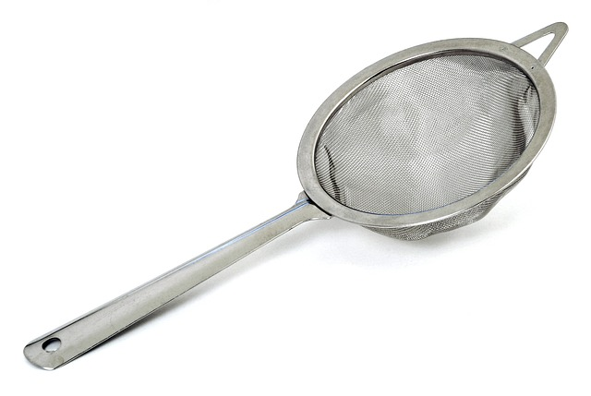

Unit Rocket Words: Year 5 – properties of materials
Careers connected to the human body:
doctor, nurse, massage therapist, personal trainer, theatre technician
Rocket Words
 | conductive | a material that allows heat and/or electricity to pass through it
 | magnetic | material that is attracted to a magnet
 | thermal | using or producing heat
 | conduction | heat moving from one object to another through contact
 | hardness | resistance to scratching and pressure
 | force | when an object is acted upon by a pull or push motion in a specific direction
 | dissolve | to mix with a liquid and become part of the liquid
 | solute | a substance that can be dissolved in liquid
 | solvent | a substance that can dissolve in a solute, water is a solvent
 | substance | any material, such as sugar
 | filtering | the separation of a mixture using a tool with small holes to separate particles
 | evaporation | the process where a liquid changes into a gas
Developing Experts Copyright 2022 All Rights Reserved

