Slide 1
New English Hubs Programme Offer
Supporting Early Language Development
A school improvement course, focused on ensuring the very best outcomes in early language development
Notes:
Overview of course
Supporting Early Language Development is a CPD programme developed by a group of English Hubs with support from Speech and Language UK (formerly I CAN)
Providing support for early language is one of the founding aims of the English hub programme. The programme has been developed as part of a project to create a more consistent medium level support (MLS) offer across the English Hub network
The CPD programme consists of 5 learning sessions, each supported by gap tasks and audits to help schools identify areas of strength and weakness, and make a sustainable plan for improved practice in this vital area:
1. What is language and how does it develop?
2. Supporting Talk in school
3. Teaching words and making them stick
4. Identifying and supporting SLCN
5. Making change; sustaining change
Following time for the implementation of the learning from these sessions, there will be a final 6th session looking at schools' progress against their action plans.
Spoken language is the foundation for success in reading and phonics and poor language skills at age 5 affects reading and numeracy at age 11.
Getting it right in Reception is the beginning but just as language skills don't stop developing at age 5, neither should support for the development of language skills stop in Reception.
Whilst throughout the sessions we will discuss principles of language development from reception age, we will also highlight how these apply across KS1 and beyond.

Slide 2
What’s the big deal about early language?
Language at age 5 is the single most important factor in influencing literacy levels at age 11.
Early language skills at five are linked with employment outcomes at age 34.
Spoken language skills are important in building and maintaining relationships, understanding and expressing feelings and emotions – and problem solving.
Early language ability at two years predicts later emotional and behavioural ability
Good language at seven predicts better quality friendships at 16 years.
Notes:
SALLY ANNE
Language at age 5 is the single most important factor in influencing literacy levels at age 11. In fact, with poor early language at age five you are four times more likely to struggle with reading at age 11.
Vocabulary at age five is a strong predictor of the qualifications achieved at school leaving age and beyond.
Spoken language is a key component in all learning
The most important factor in reaching the expected levels in English and maths at seven is children’s language skills at age five.
Children who are behind in language development at age 5 are six times less likely to reach the expected standard in English at age 11, and eleven times less likely to achieve the expected level in maths
Language ability at ages three and four predicts later reading comprehension through secondary school.
Employment
Early language skills at five are linked with employment outcomes at age 34.

Slide 3
Key Aims
For the purposes of this programme, we will concentrate on the classroom/school environment, with a focus on providing:
An understanding of a working model of language through which to observe children’s language development through the primary years, and beyond.
An understanding of the stages of ‘typical’ language development concentrating on the expected milestones that occur during primary years (ages 4 to 11)
Practical classroom skills and techniques for quality first teaching in YR and KS1 that will create skilled and confident classroom practitioners and improve outcomes for all children.
Ways and tools to identify children who may not be developing language skills as expected and ways to support those children in class.
Notes:
NINA
1-2 mins
During the training the session we will also signpost to sources of information on age and stages for typical language development throughout primary to give practitioners a good understanding of language development that is the bread and butter of speech and language therapists.
Explain that the participants are going to take part in reflective tasks and share ideas. Emphasise the importance of questions and no burdensome questions and to share thoughts, ideas and questions through the session and there will be feedback points throughout the training.
The session looks particularly at language at different points in the younger years, what normal looks like with videos and examples and a clear structure and information of what the difference looks like in the language that children use exemplified by 3yr – 5yr – 7yr age groups.
Following sessions after this one will focus on strategies to track, assess and what to do where that normal development is not there.

Slide 4
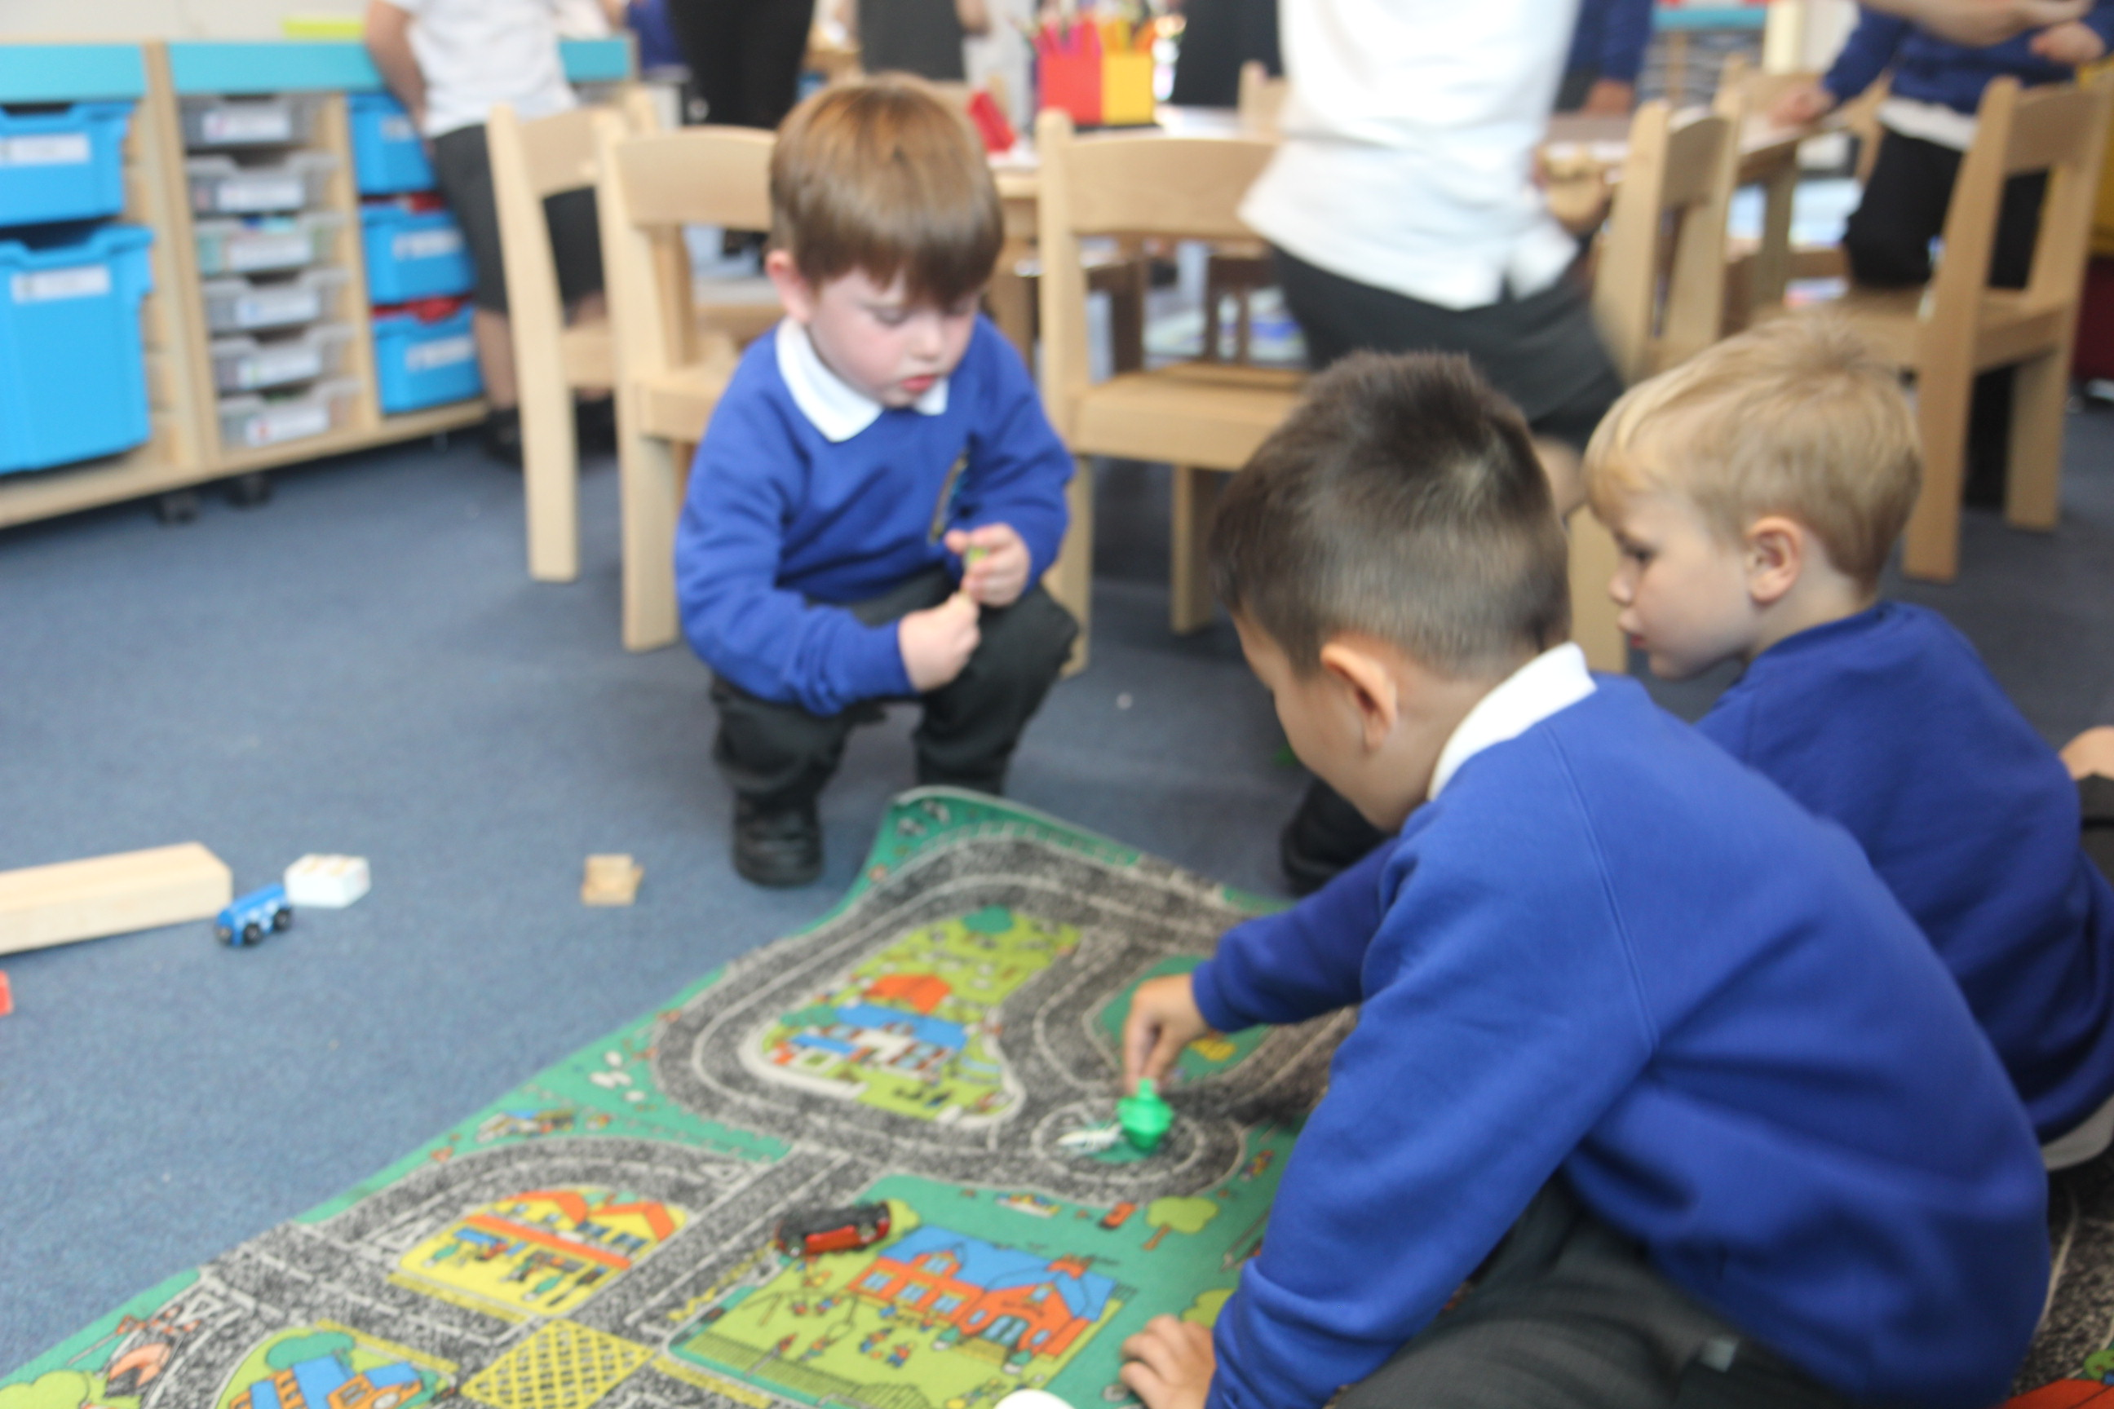
Sessions
What is language and how it is developed? (DATE)
Supporting Talk in Schools (DATE)
Teaching words and making them stick​ (DATE)
Identifying and Supporting SLCN (DATE)
Making Change: Sustaining Change​ (DATE)
Sharing the School Improvement Journey (DATE, SIX MONTHS ON)
Sessions are connected by gap tasks, which support schools in understanding their own context.
Notes:
NINA
1-2 mins
During the training the session we will also signpost to sources of information on age and stages for typical language development throughout primary to give practitioners a good understanding of language development that is the bread and butter of speech and language therapists.
Explain that the participants are going to take part in reflective tasks and share ideas. Emphasise the importance of questions and no burdensome questions and to share thoughts, ideas and questions through the session and there will be feedback points throughout the training.
The session looks particularly at language at different points in the younger years, what normal looks like with videos and examples and a clear structure and information of what the difference looks like in the language that children use exemplified by 3yr – 5yr – 7yr age groups.
Following sessions after this one will focus on strategies to track, assess and what to do where that normal development is not there.

Slide 5
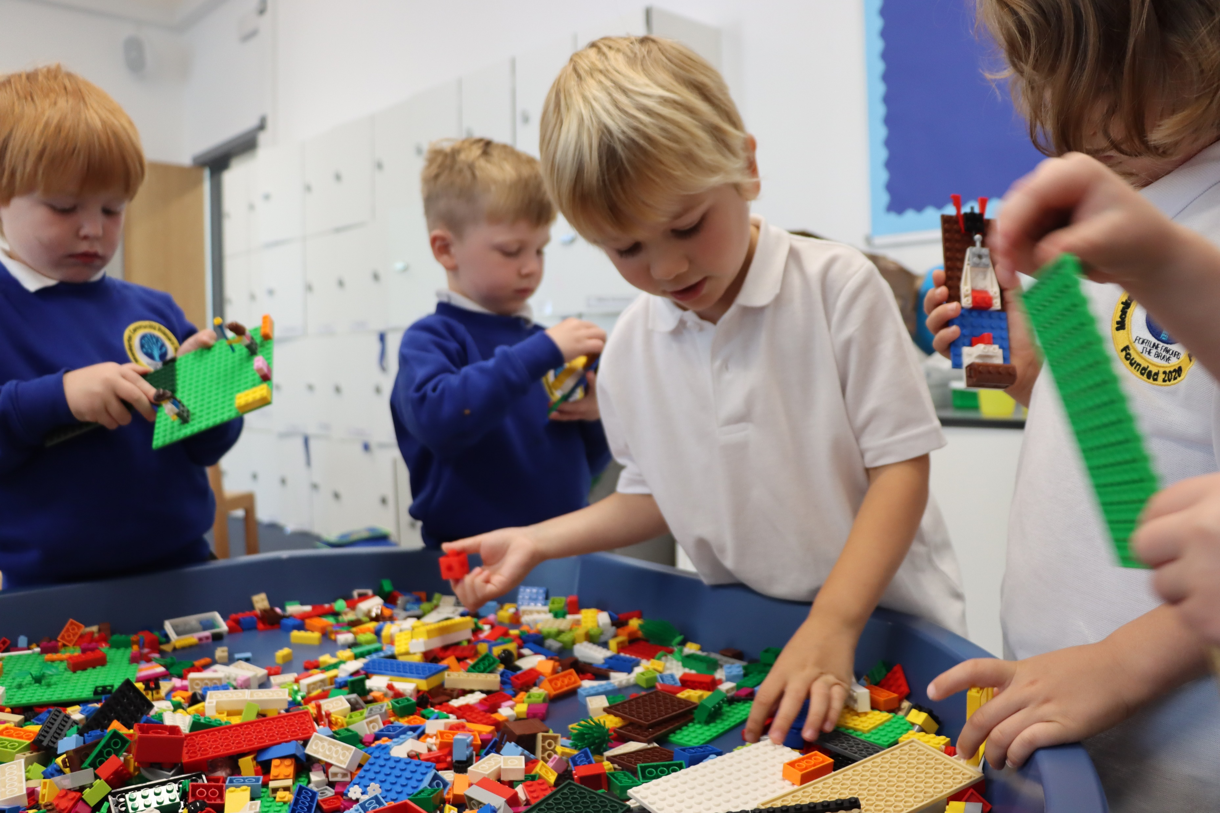
Who is invited?
2-3 people to attend from each school, taking responsibility for appropriate cascading of training through their school.
Primary target is Early Years leadership including Head Teacher, EY Phase Lead – plus one other depending on size of school.
SENDCo is also suggested for some sessions.
Focus will primarily be on Reception but refer to all Early Years teachers.
Notes:
NINA
1-2 mins
During the training the session we will also signpost to sources of information on age and stages for typical language development throughout primary to give practitioners a good understanding of language development that is the bread and butter of speech and language therapists.
Explain that the participants are going to take part in reflective tasks and share ideas. Emphasise the importance of questions and no burdensome questions and to share thoughts, ideas and questions through the session and there will be feedback points throughout the training.
The session looks particularly at language at different points in the younger years, what normal looks like with videos and examples and a clear structure and information of what the difference looks like in the language that children use exemplified by 3yr – 5yr – 7yr age groups.
Following sessions after this one will focus on strategies to track, assess and what to do where that normal development is not there.

Slide 6
New English Hubs Programme Offer
Supporting Early Language Development
A school improvement course, focused on ensuring the very best outcomes in early language development
Notes:
Overview of course
Supporting Early Language Development is a CPD programme developed by a group of English Hubs with support from Speech and Language UK (formerly I CAN)
Providing support for early language is one of the founding aims of the English hub programme. The programme has been developed as part of a project to create a more consistent medium level support (MLS) offer across the English Hub network
The CPD programme consists of 5 learning sessions, each supported by gap tasks and audits to help schools identify areas of strength and weakness, and make a sustainable plan for improved practice in this vital area:
1. What is language and how does it develop?
2. Supporting Talk in school
3. Teaching words and making them stick
4. Identifying and supporting SLCN
5. Making change; sustaining change
Following time for the implementation of the learning from these sessions, there will be a final 6th session looking at schools' progress against their action plans.
Spoken language is the foundation for success in reading and phonics and poor language skills at age 5 affects reading and numeracy at age 11.
Getting it right in Reception is the beginning but just as language skills don't stop developing at age 5, neither should support for the development of language skills stop in Reception.
Whilst throughout the sessions we will discuss principles of language development from reception age, we will also highlight how these apply across KS1 and beyond.

