Slide 1

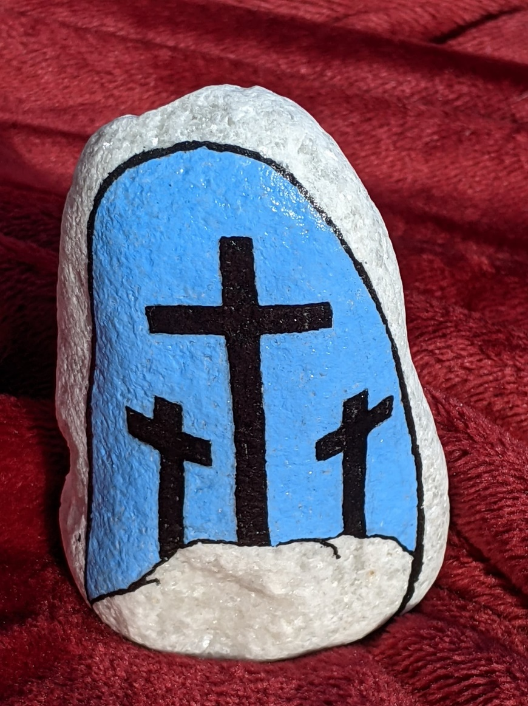

Ashford Town Parish, Good Friday Family Service, 2nd April, 9.50 for 10am on Zoom
Scavenger Hunt, make an Easter Garden, hear the Easter story, song, bring a snack! Contact Bruce or your local area for the zoom log in: bruce.watson@ashfordchurches.co.uk

