Slide 1


Science
Properties and Changes of Materials
Year One
Science | Year 5 | Properties and Changes of Materials | Irreversible Changes | Lesson 6

Slide 2
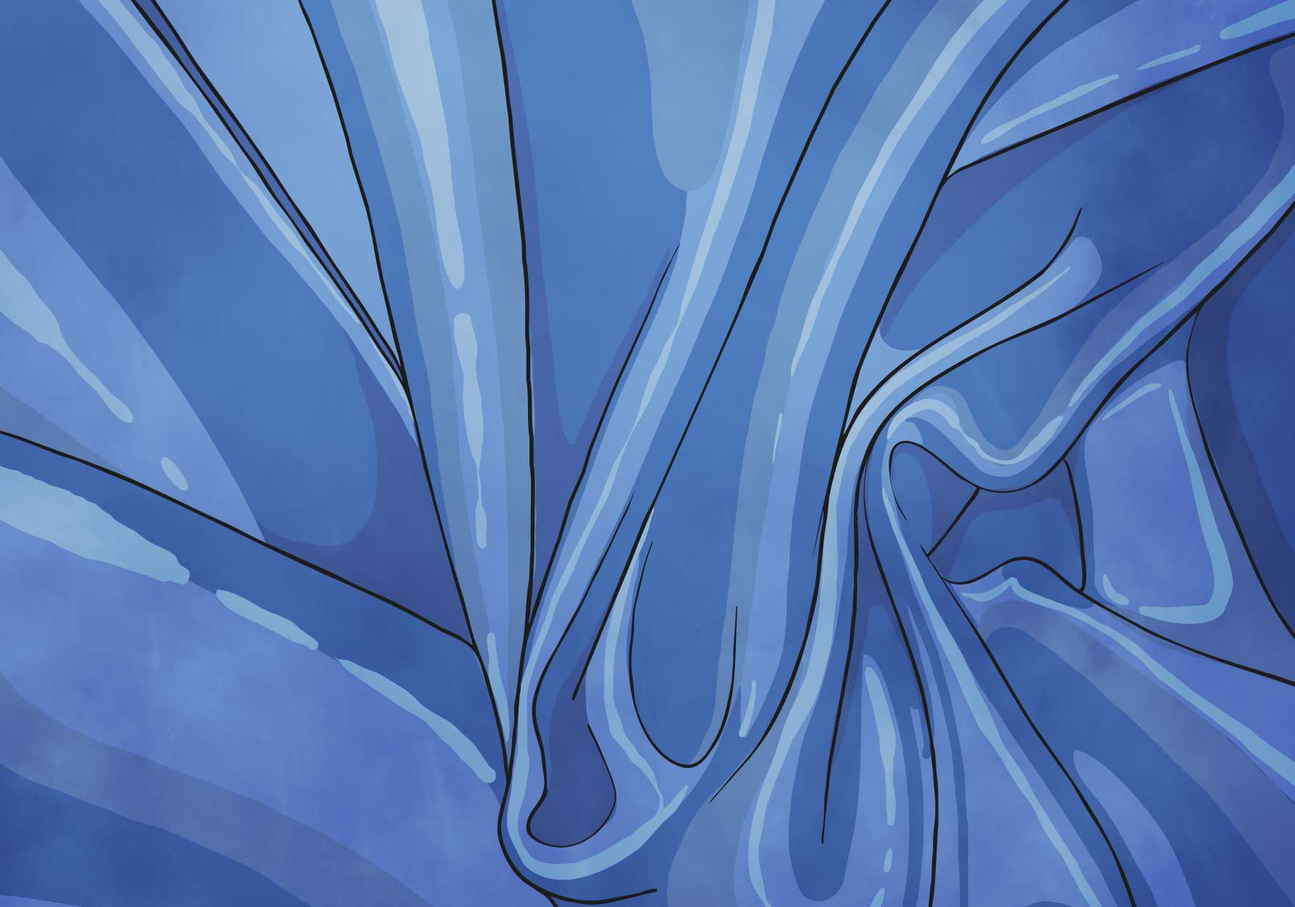

Irreversable Changes

Slide 3
Aim
I can identify and explain irreversible chemical changes.
Success Criteria
I can identify irreversible chemical changes.
I can explain irreversible chemical changes.
I can describe the new materials created in irreversible chemical changes.

Slide 4

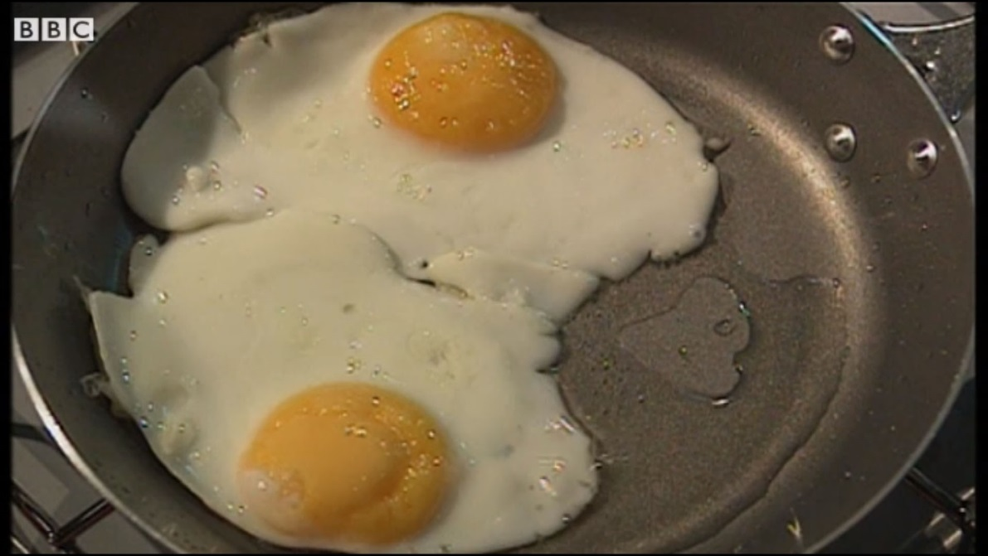

Kitchen Creations
The kitchen is where our food is made and cooked. But did you know it is also home to many scientific reactions?
Watch this clip to find out more about the science of cooking.

Slide 5


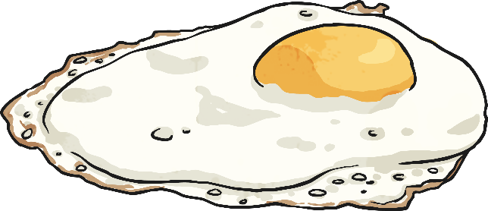
Kitchen Creations
In the clip, we saw eggs being cooked.
How did the eggs change?
The egg shell is cracked, and the raw egg pours into the pan. As the liquid egg white and yolk are heated, they start to change. The clear liquid egg white firms up and becomes opaque white. It changes into a solid. The orange liquid egg yolk also solidifies and turns lighter in colour.

Slide 6
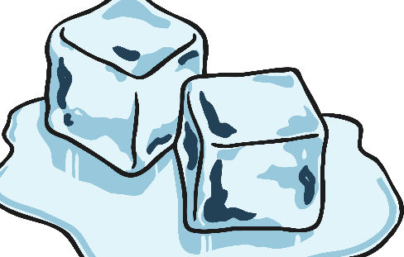
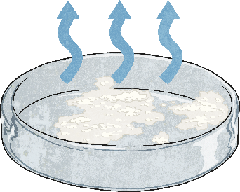
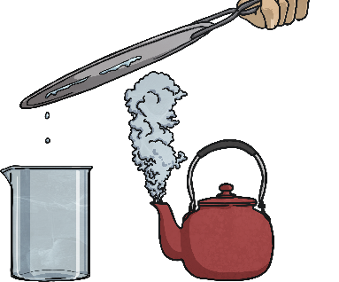
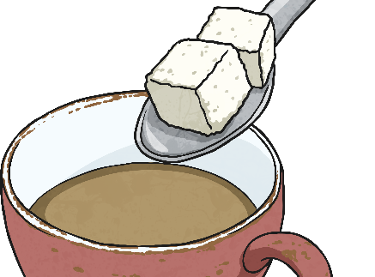
Kitchen Creations
The heat causes an irreversible chemical change to occur.
The cooked egg cannot be cooled and turned back into a raw egg.
It is a chemical change because a new product has been made, and irreversible because it cannot be changed back.
Melting, freezing, evaporating, condensing and dissolving are examples of reversible physical changes.
These are physical changes because no new materials are created. They are reversible changes because they can be changed back or reversed.

Slide 7


Kitchen Creations
Chemical changes involve reactants and products.
The reactants are the materials that you start off with,
before the chemical change happens.
The products are the materials that are formed in the chemical change.
What was the reactant and what was the product in the egg example? What caused the chemical change?

Slide 8

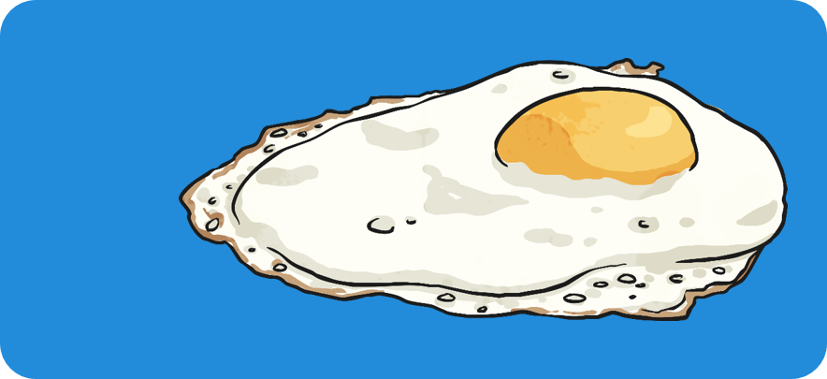
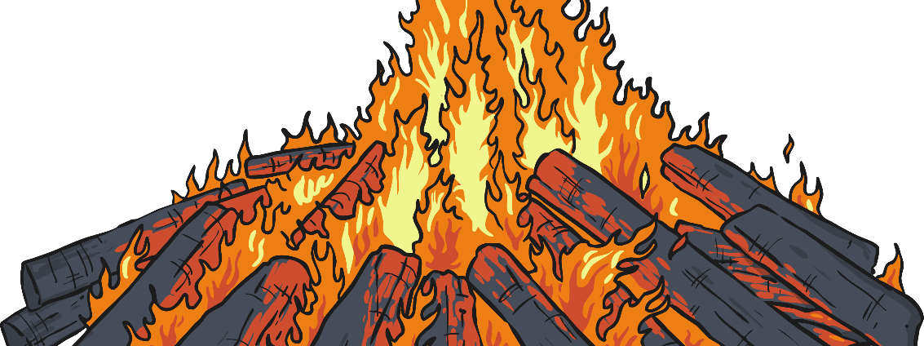
Kitchen Creations
The reactant
was the raw egg.
The product
was the cooked egg.
Heat caused the chemical change to occur.

Slide 9



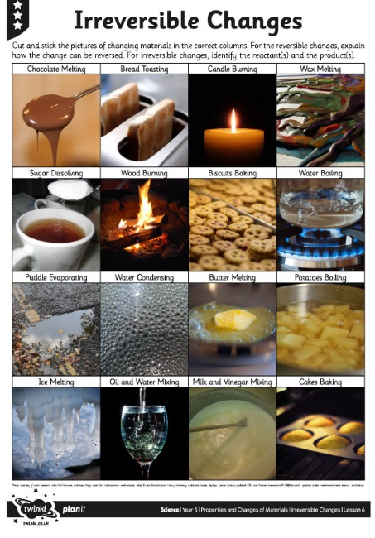
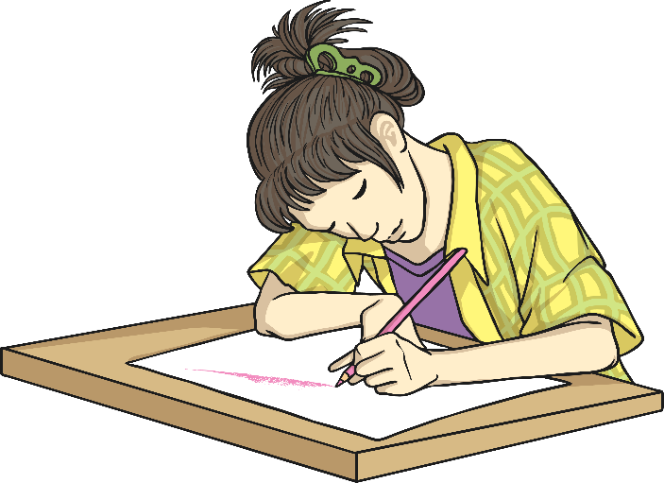
Reversible or Irreversible?
Can you sort the pictures of changes into the Reversible or Irreversible columns on your Identifying Changes Activity Sheet?

Slide 10

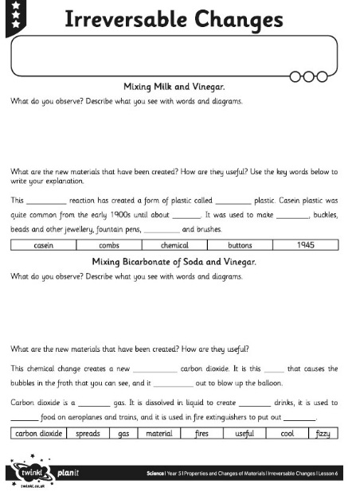

Seeing Changes
Try some irreversible changes for yourself! Can you make any new materials? Complete your Irreversible Changes Activity Sheet as you carry out the activities.

Slide 11
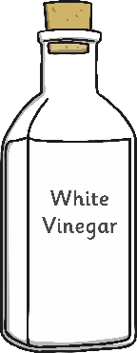
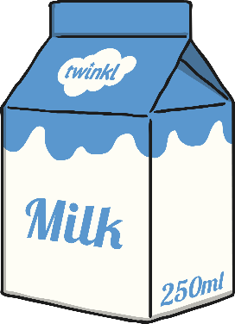
Seeing Changes –
Mixing Milk and Vinegar
Mix 250ml of warm milk with a tablespoon of white vinegar.
What do you observe?
As you mix the vinegar with the milk, it begins to curdle. It separates into clumps of solids floating in thin watery liquid.
Strain the mixture to separate the solids from the liquid.
The solids you are left with are a new material. This chemical reaction has created a form of plastic called casein plastic.
The casein plastic can be moulded into shapes and left to dry.

Slide 12
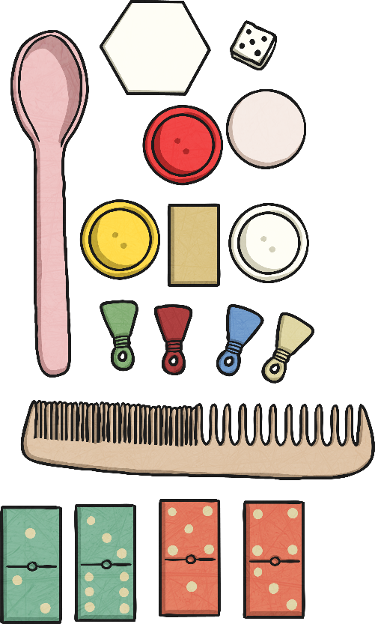
Seeing Changes –
Mixing Milk and Vinegar
Casein plastic was quite common from the early 1900s until about 1945. It was used to make buttons, decorative buckles, beads and other jewellery, fountain pens, the backings for hand-held mirrors, and fancy comb and brush sets.

Slide 13
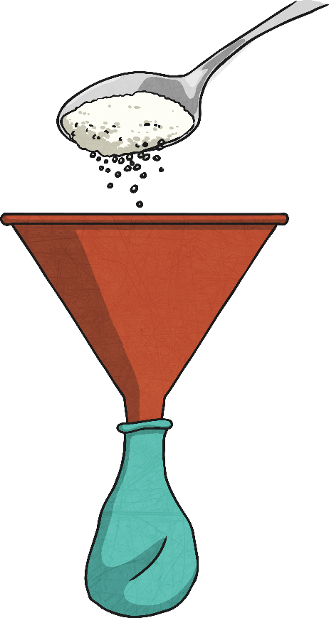
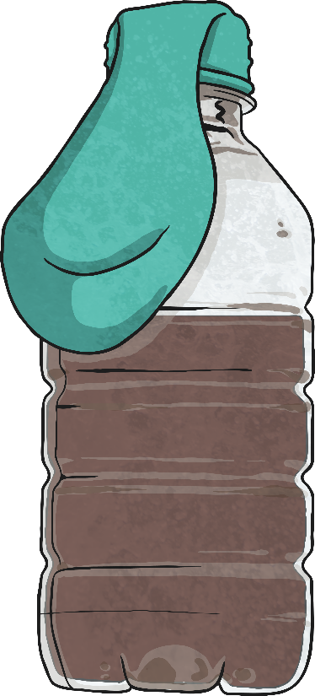
Seeing Changes – Mixing
Bicarbonate of Soda and Vinegar
Use a cardboard cone to put 50g of bicarbonate of soda into a balloon.
Pour 50ml of white vinegar into a plastic bottle.
Stretch the balloon over the top of the bottle without letting the bicarbonate of soda fall in.
Lift up the balloon to let the bicarbonate of soda fall into the vinegar.

Slide 14
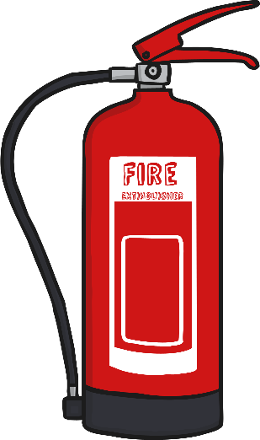


Seeing Changes – Mixing
Bicarbonate of Soda and Vinegar
As you mix the vinegar with the bicarbonate of soda, they react with each other. They create a new material - carbon dioxide. It is this gas that causes the bubbles in the froth that you can see.
The carbon dioxide gas spreads out to blow up the balloon.
What did you observe?
Carbon dioxide is a useful gas. It is dissolved in liquid to create fizzy drinks, it is used to cool food on aeroplanes and trains, and it is used in fire extinguishers to put out fires.

Slide 15
True or False?
Use what you have learnt to decide whether these questions are true or false. After you have made your decisions click on the questions to see if you were correct.
An irreversible change is one that cannot be changed back.
False
True
Melting chocolate is an irreversible change.
False
Heating materials always causes reversible changes.
Baking bread is an irreversible change.
False
True
Reversible changes create new materials.
True
Irreversible changes can create useful materials.

Slide 16

Aim
I can identify and explain irreversible chemical changes.
Success Criteria
I can identify irreversible chemical changes.
I can explain irreversible chemical changes.
I can describe the new materials created in irreversible chemical changes.

