Slide 1


Slide 3
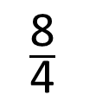
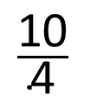
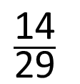
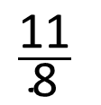
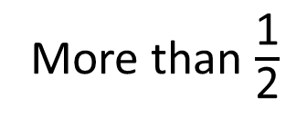
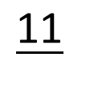
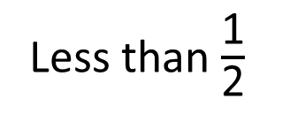
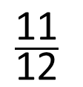
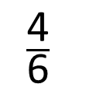
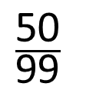
1) Put the fractions in the correct box
2)
3)
$$\frac{\text{4}}{\text{6}}$$
Less than $\frac{\text{1}}{\text{2}}$
More than $\frac{\text{1}}{\text{2}}$
$$\frac{\text{14}}{\text{29}}$$
$$\frac{\text{8}}{\text{4}}$$
$$\frac{\text{50}}{\text{99}}$$
$$\frac{\text{11}}{\text{12}}$$
>
$$\frac{\text{11}}{}$$
$$\frac{\text{11}}{\text{8}}$$
$$\frac{\text{10}}{\text{4}}$$

Slide 4
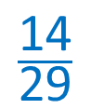
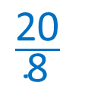

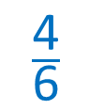

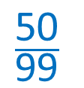
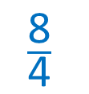
1) Put the fractions in the correct box
2)
3)
$$\frac{\text{4}}{\text{6}}$$
Less than $\frac{\text{1}}{\text{2}}$
More than $\frac{\text{1}}{\text{2}}$
$$\frac{\text{14}}{\text{29}}$$
$$\frac{\text{8}}{\text{4}}$$
$$\frac{\text{50}}{\text{99}}$$
$$\frac{\text{11}}{\text{12}}$$
>
$$\frac{\text{11}}{}$$
$$\text{1}\text{3}$$
$$\text{A}\text{ny} \text{integer} \text{greater} \text{than}\text{ 12}$$
$$\frac{\text{11}}{\text{8}}$$
<
$$\frac{\text{10}}{\text{4}}$$
$$\frac{\text{20}}{\text{8}}$$

Slide 6
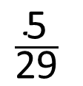
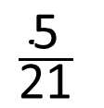
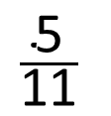
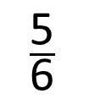
Write these fractions in ascending order.
$$\frac{\text{5}}{\text{11}}$$
$$\frac{\text{5}}{\text{21}}$$
$$\frac{\text{5}}{\text{6}}$$
$$\frac{\text{5}}{\text{29}}$$
When the numerators are the same, the greater the denominator, the smaller the fraction.

Slide 7

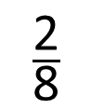
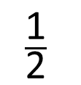
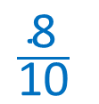
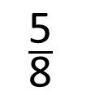
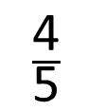
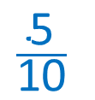
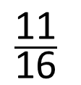
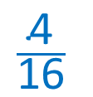
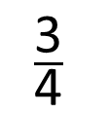
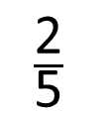
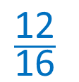
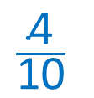
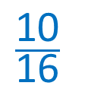
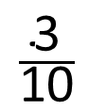
$$\frac{\text{10}}{\text{16}}$$
$$\frac{\text{12}}{\text{16}}$$
$$\frac{\text{4}}{\text{16}}$$
$$\frac{\text{11}}{\text{16}}$$
$$\frac{\text{5}}{\text{8}}$$
$$\frac{\text{3}}{\text{4}}$$
$$\frac{\text{2}}{\text{8}}$$
Smallest
Greatest
When the denominators are the same, the greater the numerator, the greater the fraction.
$$\frac{\text{5}}{\text{10}}$$
$$\frac{\text{8}}{\text{10}}$$
$$\frac{\text{4}}{\text{10}}$$
Have a think
$$\frac{\text{1}}{\text{2}}$$
$$\frac{\text{3}}{\text{10}}$$
$$\frac{\text{4}}{\text{5}}$$
$$\frac{\text{2}}{\text{5}}$$
Smallest
Greatest

Slide 8
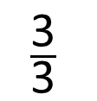
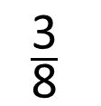
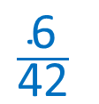
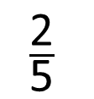
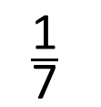
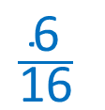
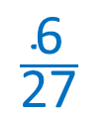
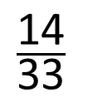
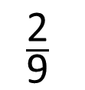
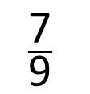
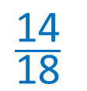
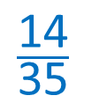
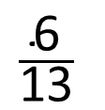
$$\frac{\text{14}}{\text{35}}$$
$$\frac{\text{14}}{\text{18}}$$
1
$$\frac{\text{14}}{\text{33}}$$
$$\frac{\text{2}}{\text{5}}$$
$$\frac{\text{7}}{\text{9}}$$
$$\frac{\text{3}}{\text{3}}$$
Smallest
Greatest
When the numerators are the same, the greater the denominator, the smaller the fraction.
$$\frac{\text{6}}{\text{42}}$$
$$\frac{\text{6}}{\text{16}}$$
$$\frac{\text{6}}{\text{27}}$$
Have a think
$$\frac{\text{1}}{\text{7}}$$
$$\frac{\text{3}}{\text{8}}$$
$$\frac{\text{2}}{\text{9}}$$
$$\frac{\text{6}}{\text{13}}$$
Smallest
Greatest

Slide 9
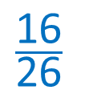
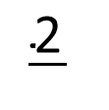
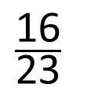
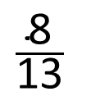

What is the missing denominator?
$$\frac{\text{16}}{}$$
$$\frac{\text{16}}{\text{26}}$$
24 or 25
25
24
$$\frac{\text{16}}{\text{23}}$$
>
$$\frac{\text{2}}{}$$
>
$$\frac{\text{8}}{\text{13}}$$
3

Slide 10
Have a go at questions
5 - 7 on the worksheet

