Slide 1


Slide 3
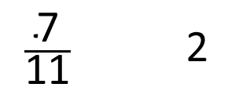
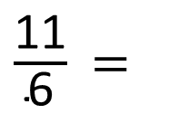

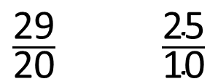
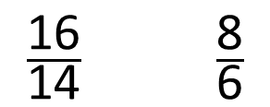

$\frac{\text{11}}{\text{6}}$ =
$\frac{\text{8}}{\text{36}}$
1)
2)
3)
4)
$\frac{\text{29}}{\text{20}}$ $\frac{\text{25}}{\text{10}}$
$\frac{\text{7}}{\text{11}}$ $\text{2}$
$$>$$
$\frac{\text{16}}{\text{14}}$ $\frac{\text{8}}{\text{6}}$

Slide 4



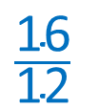

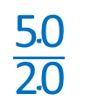
$\frac{\text{11}}{\text{6}}$ =
66
$\frac{\text{8}}{\text{36}}$
1)
2)
3)
4)
$\frac{\text{29}}{\text{20}}$ $\frac{\text{25}}{\text{10}}$
$$<$$
$$\frac{\text{50}}{\text{20}}$$
$$\text{24}$$
$\frac{\text{7}}{\text{11}}$ $\text{2}$
$$>$$
$$\text{Any} \text{integer} \text{greater} \text{than}\text{ 22}$$
$\frac{\text{16}}{\text{14}}$ $\frac{\text{8}}{\text{6}}$
$$\frac{\text{16}}{\text{12}}$$
$$<$$

Slide 6

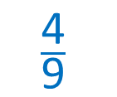
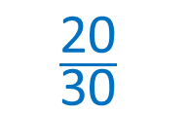
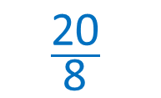
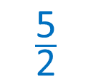
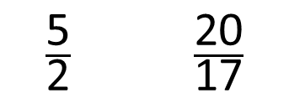

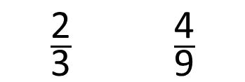
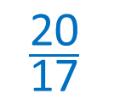
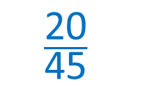

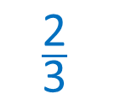
Order these fractions in ascending order.
$\frac{\text{2}}{\text{3}}$ $\frac{\text{4}}{\text{9}}$
$\frac{\text{5}}{\text{2}}$ $\frac{\text{20}}{\text{17}}$
$×$10
$×$5
$×$4
$$\frac{\text{20}}{\text{30}}$$
$$\frac{\text{20}}{\text{45}}$$
$$\frac{\text{20}}{\text{8}}$$
$$\frac{\text{4}}{\text{9}}$$
$$\frac{\text{2}}{\text{3}}$$
$$\frac{\text{20}}{\text{17}}$$
$$\frac{\text{5}}{\text{2}}$$
When the numerators are the same, the greater the denominator, the smaller the fraction.

Slide 7

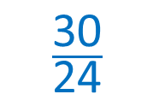
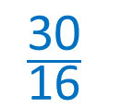
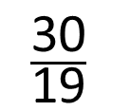

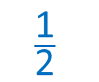
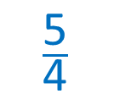
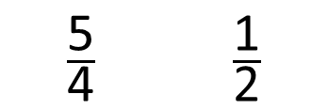
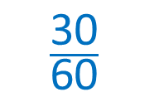
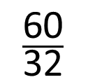
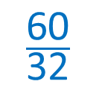


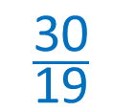
Have a think
Order these fractions in descending order.
$\frac{\text{5}}{\text{4}}$ $\frac{\text{1}}{\text{2}}$
$$\frac{\text{30}}{\text{19}}$$
$$\frac{\text{60}}{\text{32}}$$
$×$6
$×$30
$÷$ 2
$$\frac{\text{30}}{\text{24}}$$
$$\frac{\text{30}}{\text{60}}$$
$$\frac{\text{30}}{\text{16}}$$
$$\frac{\text{60}}{\text{32}}$$
$$\frac{\text{30}}{\text{19}}$$
$$\frac{\text{5}}{\text{4}}$$
$$\frac{\text{1}}{\text{2}}$$
When the numerators are the same, the greater the denominator, the smaller the fraction.

Slide 8

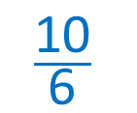
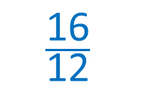
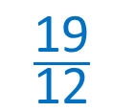
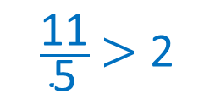
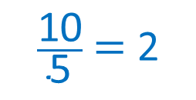
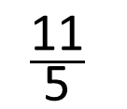
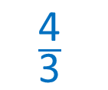
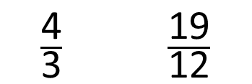
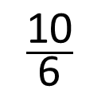
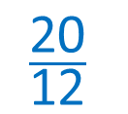

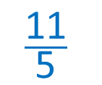
Order these fractions in ascending order.
$\frac{\text{4}}{\text{3}}$ $\frac{\text{19}}{\text{12}}$
$$\frac{\text{11}}{\text{5}}$$
$$\frac{\text{10}}{\text{6}}$$
$×$4
$×$2
$$\frac{\text{16}}{\text{12}}$$
10 is double 5
$$\frac{\text{20}}{\text{12}}$$
$\frac{\text{10}}{\text{5}}$ $=$ 2
$\frac{\text{11}}{\text{5}}$ $>$ 2
$$\frac{\text{4}}{\text{3}}$$
$$\frac{\text{19}}{\text{12}}$$
$$\frac{\text{10}}{\text{6}}$$
$$\frac{\text{11}}{\text{5}}$$
When the denominators are the same, the greater the numerator, the greater the fraction.

Slide 9
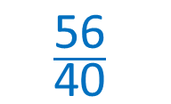
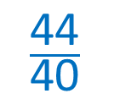
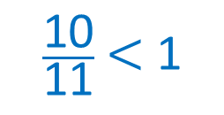
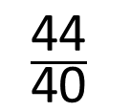
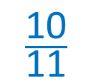
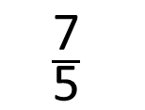
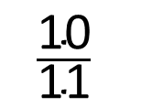
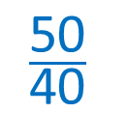
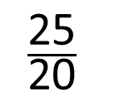
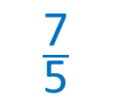


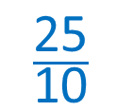
Have a think
Order these fractions in ascending order.
proper fraction
$$\frac{\text{10}}{\text{11}}$$
$$\frac{\text{7}}{\text{5}}$$
$$\frac{\text{44}}{\text{40}}$$
$$\frac{\text{25}}{\text{20}}$$
$×$8
$×$2
$\frac{\text{10}}{\text{11}}$ < 1
$$\frac{\text{56}}{\text{40}}$$
$$\frac{\text{50}}{\text{40}}$$
$$\frac{\text{10}}{\text{11}}$$
$$\frac{\text{44}}{\text{40}}$$
$$\frac{\text{25}}{\text{10}}$$
$$\frac{\text{7}}{\text{5}}$$
When the denominators are the same, the greater the numerator, the greater the fraction.

Slide 10
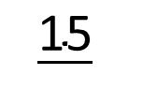

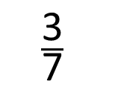
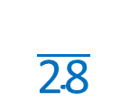








$$\frac{\text{5}}{\text{7}}$$
$$\frac{\text{15}}{}$$
$$\frac{\text{15}}{\text{9}}$$
<
<
11
$×$3
$$\frac{\text{15}}{\text{21}}$$
Any integer between 10 and 20
When the numerators are the same, the greater the denominator, the smaller the fraction.
Have a think
$$\frac{\text{2}}{\text{28}}$$
3
$$\frac{\text{3}}{\text{7}}$$
<
$$\frac{}{\text{14}}$$
<
$×$2
$×$4
6
Any integer between 3 and 11?
7
Any even integer between 3 and 11
$$\frac{}{\text{28}}$$
$$\frac{\text{12}}{\text{28}}$$

Slide 11




$$\frac{\text{1}}{\text{2}}$$
12
$$\frac{\text{18}}{\text{21}}$$
<
$$\frac{}{\text{21}}$$
<
Half of 21 $=$ 10.5
Any integer between 11 and 17

Slide 12



Rosie and Jack each have 3 identical chew bars.
Jack divides each of his bars into 4 equal pieces and eats 5 pieces.
Rosie divides each of her bars into 2 equal pieces and eats 5 pieces.
We’ve both eaten the same amount because we’ve both eaten 5 pieces.
Have a think
Explain why Jack is not correct.

Slide 13







$\frac{\text{7}}{\text{4}}$ remaining
$$\frac{\text{12}}{\text{4}}$$
$\frac{\text{1}}{\text{2}}$ remaining
$$\frac{\text{6}}{\text{2}}$$
$$\frac{\text{7}}{\text{4}}$$
>
$$\frac{\text{1}}{\text{2}}$$
$$\frac{\text{2}}{\text{4}}$$

Slide 14
Have a go at questions
5 - 8 on the worksheet

