Slide 1


Slide 3
1) What fraction of the bar is shaded blue?
2) What fraction of the bar is shaded green?
3) How many parts are yellow?

Slide 4
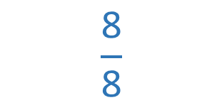
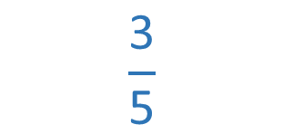
1) What fraction of the bar is shaded blue?
2) What fraction of the bar is shaded green?
3) How many parts are yellow?
$$\frac{\text{3}}{\text{5}}$$
$$\frac{\text{8}}{\text{8}}$$
5 parts

Slide 6
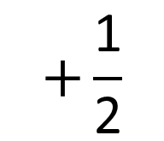
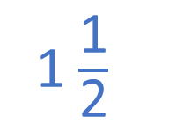
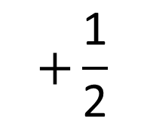
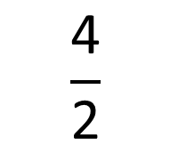
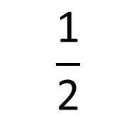
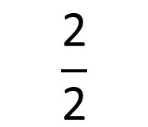
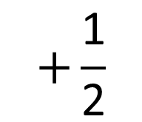
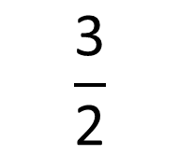
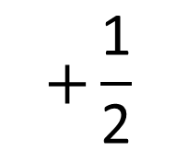
$$+\frac{\text{1}}{\text{2}}$$
$$+\frac{\text{1}}{\text{2}}$$
$$+\frac{\text{1}}{\text{2}}$$
$$+\frac{\text{1}}{\text{2}}$$
0
$$\frac{\text{1}}{\text{2}}$$
$$\frac{\text{2}}{\text{2}}$$
$$\frac{\text{3}}{\text{2}}$$
$$\frac{\text{4}}{\text{2}}$$
1
1 $\frac{\text{1}}{\text{2}}$
2

Slide 7
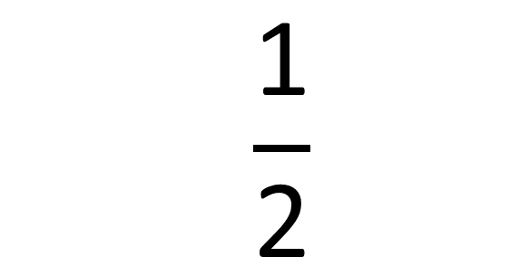
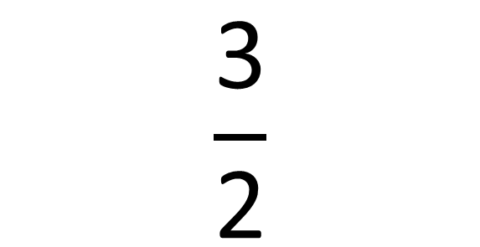
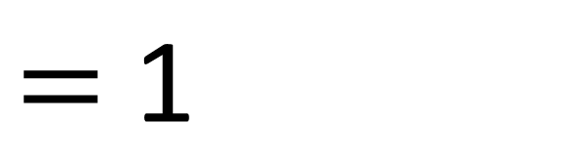
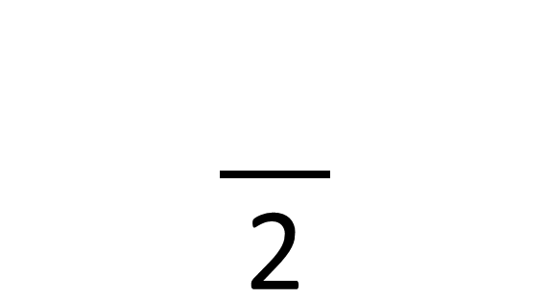
This is an improper fraction.
An improper fraction is where the numerator is greater than the denominator.
This is a mixed number.
It is a number with a whole and a fraction.
$$\frac{}{\text{2}}$$
$$\frac{\text{1}}{\text{2}}$$
$$\frac{\text{3}}{\text{2}}$$
$=$ $\text{1}$

Slide 8
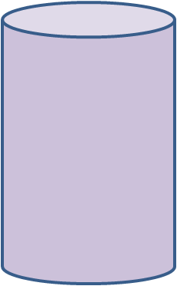
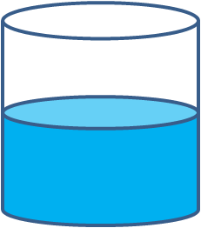

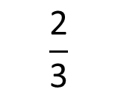
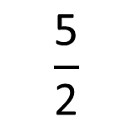
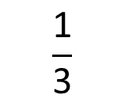
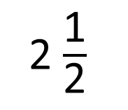
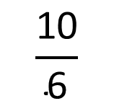
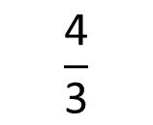
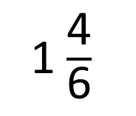
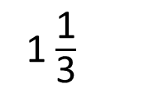
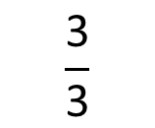
How do the representations show mixed numbers and improper fractions?
$$\frac{\text{3}}{\text{3}}$$
$$\frac{\text{4}}{\text{3}}$$
0
$$\frac{\text{1}}{\text{3}}$$
$$\frac{\text{2}}{\text{3}}$$
1
1$\frac{\text{1}}{\text{3}}$
2
$$\frac{\text{10}}{\text{6}}$$
2$\frac{\text{1}}{\text{2}}$
$$\frac{\text{5}}{\text{2}}$$
1$\frac{\text{4}}{\text{6}}$
Have a think

Slide 9
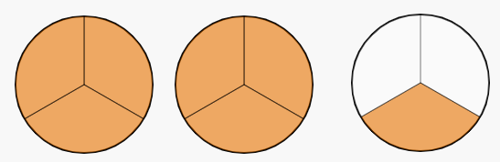
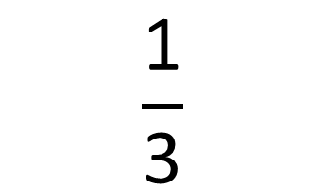
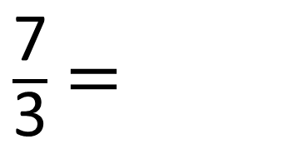
Convert the improper fraction to a mixed number
$$\frac{\text{1}}{\text{3}}$$
$\frac{\text{7}}{\text{3}}$ $=$
2

Slide 10
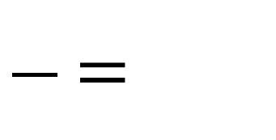
Convert the improper fraction to a mixed number
$=$
Have a think

Slide 11
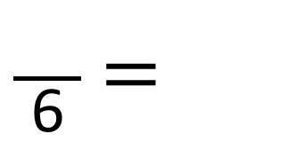
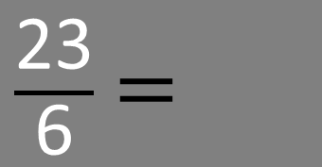
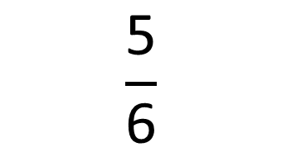
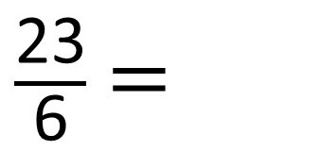
Convert the improper fraction to a mixed number
$$\frac{\text{5}}{\text{6}}$$
$\frac{\text{23}}{\text{6}}$ $=$
$\frac{\text{23}}{\text{6}}$ $=$
$\frac{\text{23}}{\text{6}}$ $=$
3

Slide 12
Have a go at questions 1 and 2 on the worksheet

Slide 13
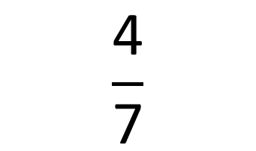
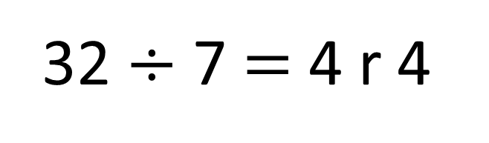

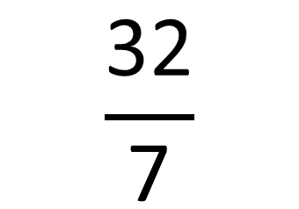
Convert the improper fractions to mixed numbers.
$$\frac{\text{32}}{\text{7}}$$
$$=$$
$$\frac{\text{4}}{\text{7}}$$
32 $÷$ 7 $=$ 4 r 4

Slide 14
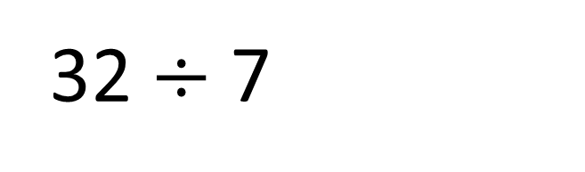
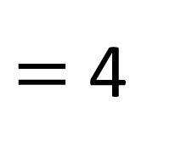

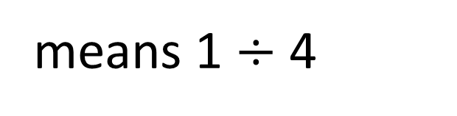
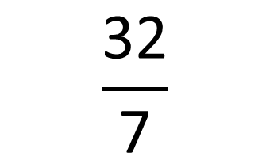
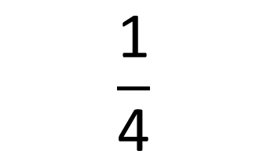
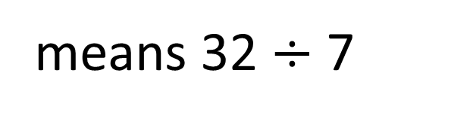
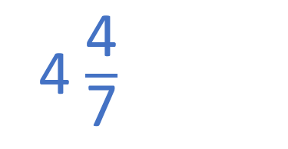
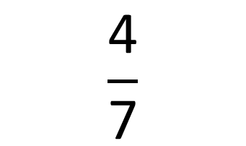
Convert the improper fractions to mixed numbers.
$$\frac{\text{1}}{\text{4}}$$
$$\frac{\text{32}}{\text{7}}$$
4 $\frac{\text{4}}{\text{7}}$
means 1 $÷$ 4
means 32 $÷$ 7
so
$$=$$
$$\frac{\text{4}}{\text{7}}$$
r 4
32 $÷$ 7
$=$ 4

Slide 15
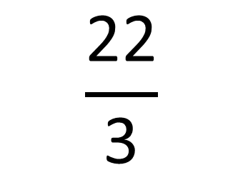
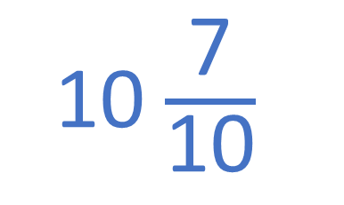

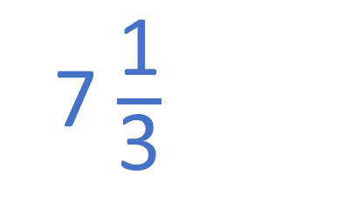
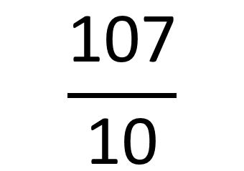

Have a think
Convert the improper fractions to mixed numbers
$$\frac{\text{107}}{\text{10}}$$
10 $\frac{\text{7}}{\text{10}}$
$$\frac{\text{22}}{\text{3}}$$
7 $\frac{\text{1}}{\text{3}}$
$$=$$
$$=$$

Slide 16
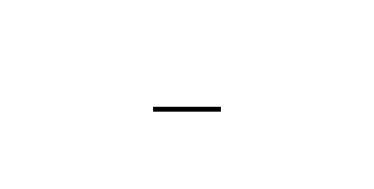


Find the value of and
$$\frac{\text{25}}{}$$
8
$$=$$
Have a think

Slide 17







Find the value of and
$$\frac{\text{25}}{}$$
8
$$=$$
25 $÷$ $=$ $\text{8}$ r
25 $÷$ 8 $=$ r
12 $÷$3 = 4
12 $÷$4 = 3

Slide 18






Find the value of and
3
1
25 $÷$ $=$ $\text{8}$ r
25 $÷$ 8 $=$ r
$$\frac{\text{25}}{\text{3}}$$
$$\frac{\text{1}}{\text{3}}$$
25 $÷$ 8 $=$
3 r 1
$$=$$
8

Slide 19
Have a go at the rest of the questions on the worksheet

