Slide 1
DIVIDE BY 10

Slide 3
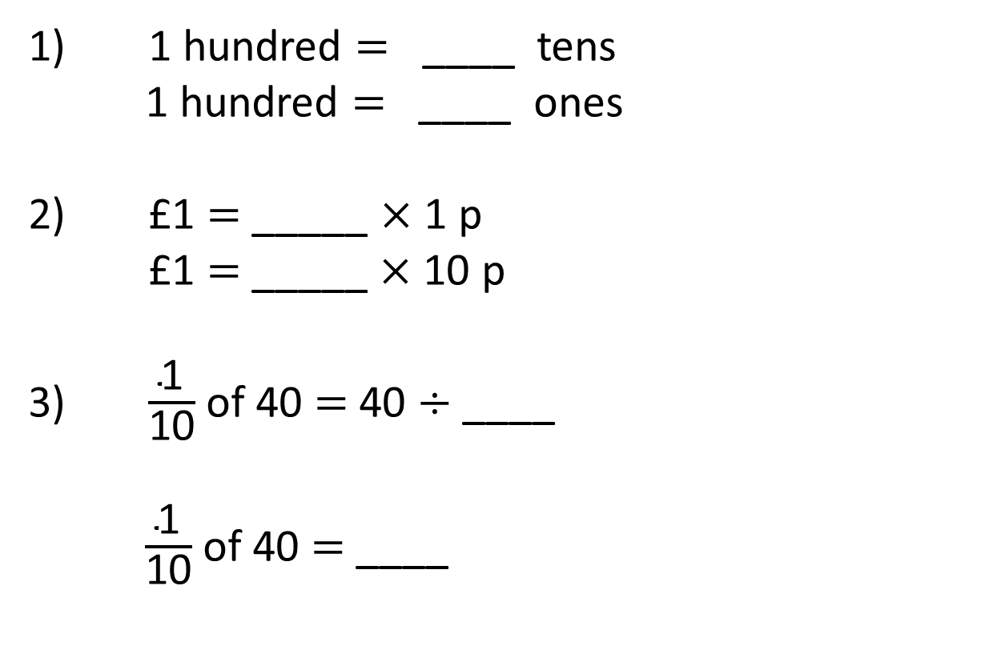
1) 1 hundred = ____ tens
1 hundred $=$ ____ ones
2) £1 = _____ $×$ 1 p
£1 $=$ _____ $×$ 10 p
3) $\frac{\text{1}}{\text{10}}$ of 40 $=$ 40 $÷$ ____
$\frac{\text{1}}{\text{10}}$ of 40 $=$ ____

Slide 4
10
1) 1 hundred = ____ tens
1 hundred $=$ ____ ones
2) £1 = _____ $×$ 1 p
£1 $=$ _____ $×$ 10 p
3) $\frac{\text{1}}{\text{10}}$ of 40 $=$ 40 $÷$ ____
$\frac{\text{1}}{\text{10}}$ of 40 $=$ ____
100
100
10
10
4

Slide 6
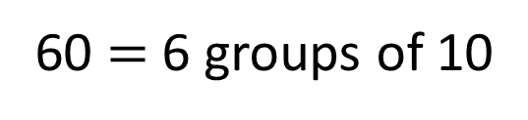
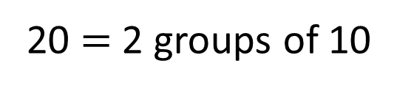
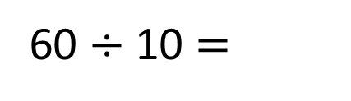
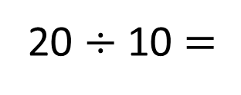
20 $÷$ 10 $=$
2
20 $=$ 2 groups of 10
6
60 $÷$ 10 $=$
60 $=$ 6 groups of 10

Slide 7
Have a go at questions
1 - 3 on the worksheet

Slide 8

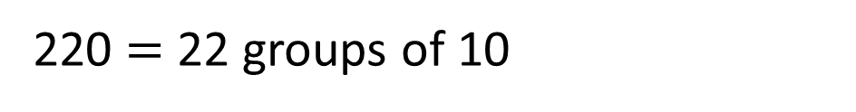
220 ÷ 10 = ___
22
220 = 2 hundreds + 2 tens
We need to find how many groups of 10 are in 220
1 hundred = 10 tens
2 hundreds = 20 tens
There are 22 tens altogether.
220 $=$ 22 groups of 10

Slide 9
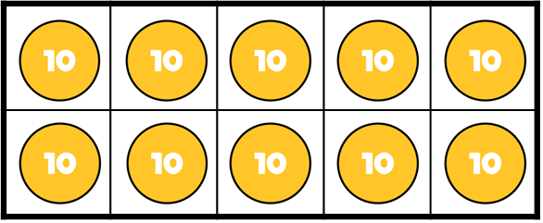
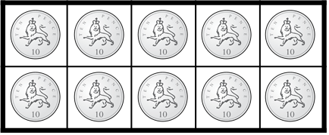
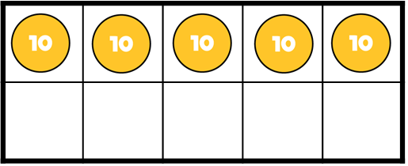
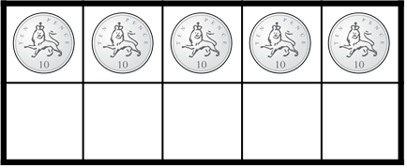
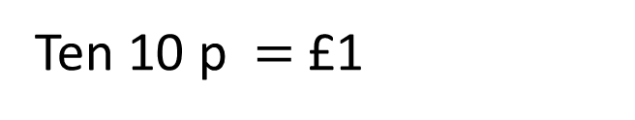

£3 and 50 p ÷ 10 p = ___
350 ÷ 10 = ___
35
35
Ten 10s $=$ 1 hundred
Ten 10 p $=$ £1

Slide 10
Have a go at questions
4 - 6 on the worksheet

Slide 11
Th | H | T | O
10 times
the size
10 times
the size
10 times
the size

Slide 12
Th | H | T | O
One tenth
the size
One tenth
the size
One tenth
the size
To find one tenth, we divide by 10

Slide 13






$×$ 10
$×$ 10
$×$ 10
Th | H | T | O
$÷$ 10
$÷$ 10
$÷$ 10

Slide 14
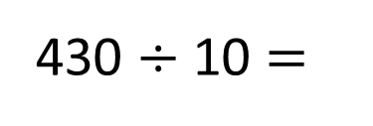



Th | H | T | O
$÷$ 10
$÷$ 10
$÷$ 10
430 $÷$ 10 =
4
3

Slide 15
Have a go at the rest of the worksheet

