Slide 1


Slide 3
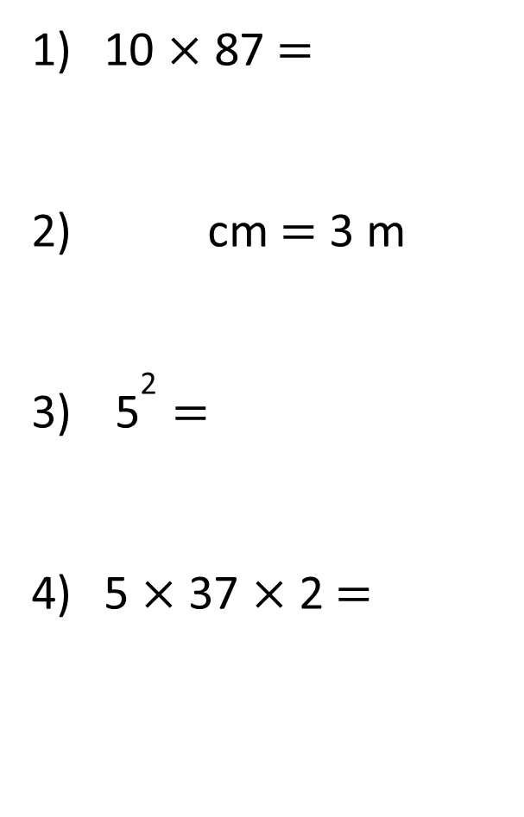
10 × 87 =
cm = 3 m
${\text{5}}^{\text{2}}$ =
5 × 37 × 2 =

Slide 4
10 × 87 =
cm = 3 m
${\text{5}}^{\text{2}}$ =
5 × 37 × 2 =
870
300
25
370

Slide 6
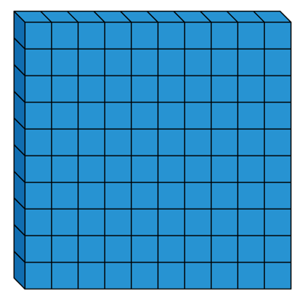
1 hundred
5 times
5 × 1 hundred =
5 hundreds
5 × 100 =
500
100 × 5 =
500

Slide 7

Have a think
6 × 100 × 9 =
6 × 9 × 100 =
54
54 × 100 =
5,400

Slide 8
× 100 = 1,300
13
What number, when it is made 100 times greater, is equal to 1,300?
Th | H | T | O

Slide 9
Have a think
1) = 100 × 44
4,400
2) 100 × = 5,100
51
2
3) 6 × 100 = 3,600
1,500
4) 100 × 13 = - 200

Slide 10
Have a go at questions
1 - 5 on the worksheet

Slide 11
How many centimetres are equal to 7 metres?
Have a think
What key fact do we need to answer this question?
1 m = 100 cm
100 cm
100 cm
100 cm
100 cm
100 cm
100 cm
100 cm
100 × 7 =
700 cm

Slide 12
=
50 × 100 10 × 500
5,000
5,000
<
10 × 49 48 × 100
Have a think
=
1) 10 × 29 × 10 50 × 29 × 2
100 × 29
100 × 29
>
2) 100 × 91 92 + 100

Slide 13

Tommy has some 100s pieces in base 10
He has 23
What number has he made?
100
23 times
100 × 23 =
2,300

Slide 14
Tommy changes the pieces that he has.
He now has 47 pieces in total.
21 of his pieces are 10s and the rest are 100s
What number has he made?
Have a think
10
21 times
21
10s
10 × 21 =
210
47
100
26 times
26
100s
100 × 26 =
2,600
210 + 2,600 =
2,810

Slide 15
Have a go at questions
6 - 9 on the worksheet

